Slide 1
W4111 – Introduction to Databases: Section 002, Spring 2021 Lecture 8: Module III: NoSQL and Graph Databases Module II: Disks
© Donald F. Ferguson, 2021

Slide 2
W4111 – Introduction to Databases: Section 002, Spring 2021 Lecture 8: Module III: NoSQL and Graph Databases Module II: Disks
We will start in a couple of minutes.
© Donald F. Ferguson, 2021

Slide 3

Contents and Agenda
3 | Introduction to Databases (S21): Lecture 8: No SQL, DB Disks and Files © Donald F. Ferguson, 2020

Slide 4
Contents
Agenda update – Parallel coverage of
Module II: DBMS internal architecture and implementation.
Module III: NoSQL.
Module II:
Overview.
Major subsystems summary.
Database disks and files.
Module III:
Overview and NoSQL concepts.
Graph databases and Neo4j.
HW 3/Project specification and discussion.

Slide 5
Class Agenda Update
5 | Introduction to Databases (S21): Lecture 8: No SQL, DB Disks and Files © Donald F. Ferguson, 2020

Slide 6
Class Agenda Update
Grades and solutions:
Midterm:
I will cover the solutions in recitation on Saturday (13-Mar; 1000Z)
Expected grade release: Sunday, 14-Mar
HW2: Expected grade release: 12-Mar
The course has 4 modules:
I) Foundation, II) DBMS Implementation and Architecture, III) NoSQL, IV) Data Analytics.
I normally cover sequentially. This results in compressing HWs 3 and 4.
New approach:
Cover Module II and Module III in parallel.
“Testing” knowledge of module II will be questions on the final exam. I will cover topics in lectures and assign slide sets to read.
HW3 and HW4 will be a two step project using SQL, NoSQL and data analysis.
HW and exams schedule remains the same.
I will update the syllabus on the class site.

Slide 7
Module II: DBMS Implementation and Architecture (Part I – Disks, Files and I/O)
7 | Introduction to Databases (S21): Lecture 8: No SQL, DB Disks and Files © Donald F. Ferguson, 2020

Slide 8

Module II – DBMS Architecture and Implementation
Overview and Reminder
8 | Introduction to Databases (S21): Lecture 8: No SQL, DB Disks and Files © Donald F. Ferguson, 2020

Slide 9
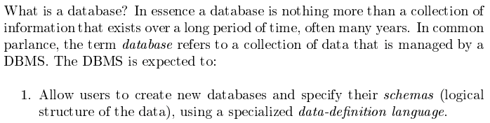
Database Management System Reminder
Covered for the relational model.
Database Systems: The Complete Book (2nd Edition) by Hector Garcia-Molina (Author), Jeffrey D. Ullman (Author), Jennifer Widom (Author)
9 | Introduction to Databases (F20): Lecture 8: Disks, I/O, Indexes © Donald F. Ferguson, 2020

Slide 10
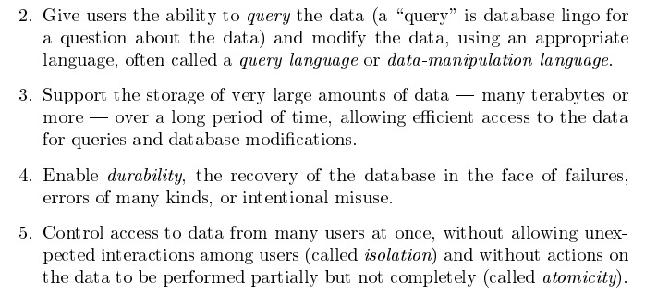
Database Management System Reminder
Focus for next part of course.
Database Systems: The Complete Book (2nd Edition) by Hector Garcia-Molina (Author), Jeffrey D. Ullman (Author), Jennifer Widom (Author)

Slide 11
Purpose of Database Systems
In the early days, database applications were built directly on top of file systems, which leads to:
Data redundancy and inconsistency: data is stored in multiple file formats resulting induplication of information in different files
Difficulty in accessing data
Need to write a new program to carry out each new task
Data isolation
Multiple files and formats
Integrity problems
Integrity constraints (e.g., account balance > 0) become “buried” in program code rather than being stated explicitly
Hard to add new constraints or change existing ones
Notes:
11

Slide 12
Purpose of Database Systems (Cont.)
Atomicity of updates
Failures may leave database in an inconsistent state with partial updates carried out
Example: Transfer of funds from one account to another should either complete or not happen at all
Concurrent access by multiple users
Concurrent access needed for performance
Uncontrolled concurrent accesses can lead to inconsistencies
Ex: Two people reading a balance (say 100) and updating it by withdrawing money (say 50 each) at the same time
Security problems
Hard to provide user access to some, but not all, data
Database systems offer solutions to all the above problems
In Module I, we explored how users interact with the (some) of the functions through DDL and DML. In this module, we will explore how DBMS implement the capabilities “under the covers.”
Notes:
12

Slide 13
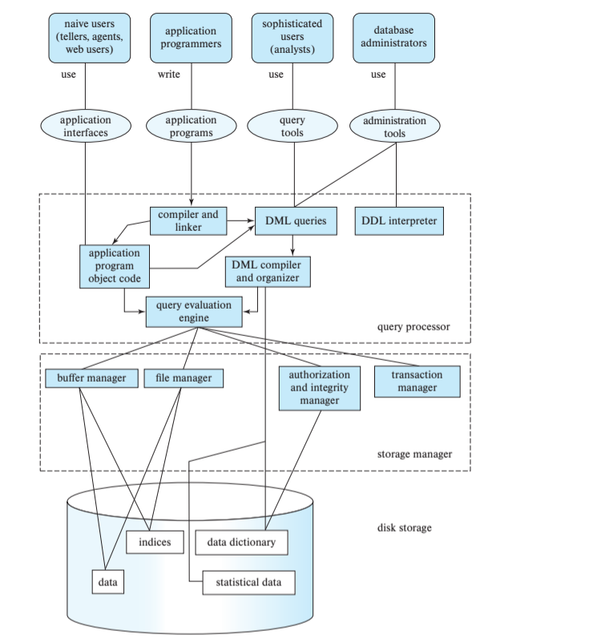
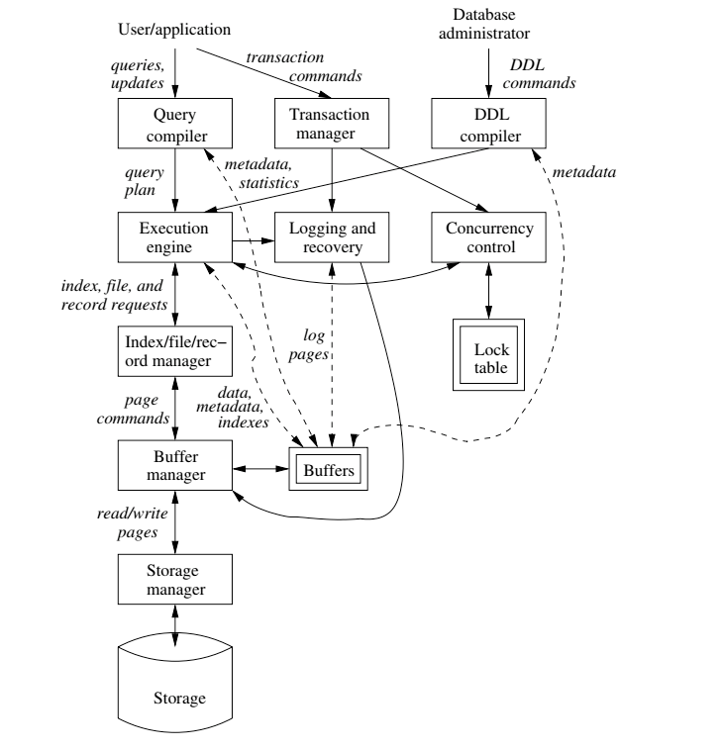
DBMS Subsystems
13 | Introduction to Databases (F20): Lecture 8: Disks, I/O, Indexes © Donald F. Ferguson, 2020

Slide 14

Data Management
Find things quickly.
Access things quickly.
Load/save things quickly.
Database Systems: The Complete Book (2nd Edition) by Hector Garcia-Molina (Author), Jeffrey D. Ullman (Author), Jennifer Widom (Author)

Slide 15
Disks Input/Output (IO)
15 | Introduction to Databases (S21): Lecture 8: No SQL, DB Disks and Files © Donald F. Ferguson, 2020

Slide 16
Disks as Far as the Eye Can See
16 | Introduction to Databases (F20): Lecture 8: Disks, I/O, Indexes © Donald F. Ferguson, 2018

Slide 17
Classification of Physical Storage Media
Can differentiate storage into:
volatile storage: loses contents when power is switched off
non-volatile storage:
Contents persist even when power is switched off.
Includes secondary and tertiary storage, as well as batter-backed up main-memory.
Factors affecting choice of storage media include
Speed with which data can be accessed
Cost per unit of data
Reliability

Slide 18
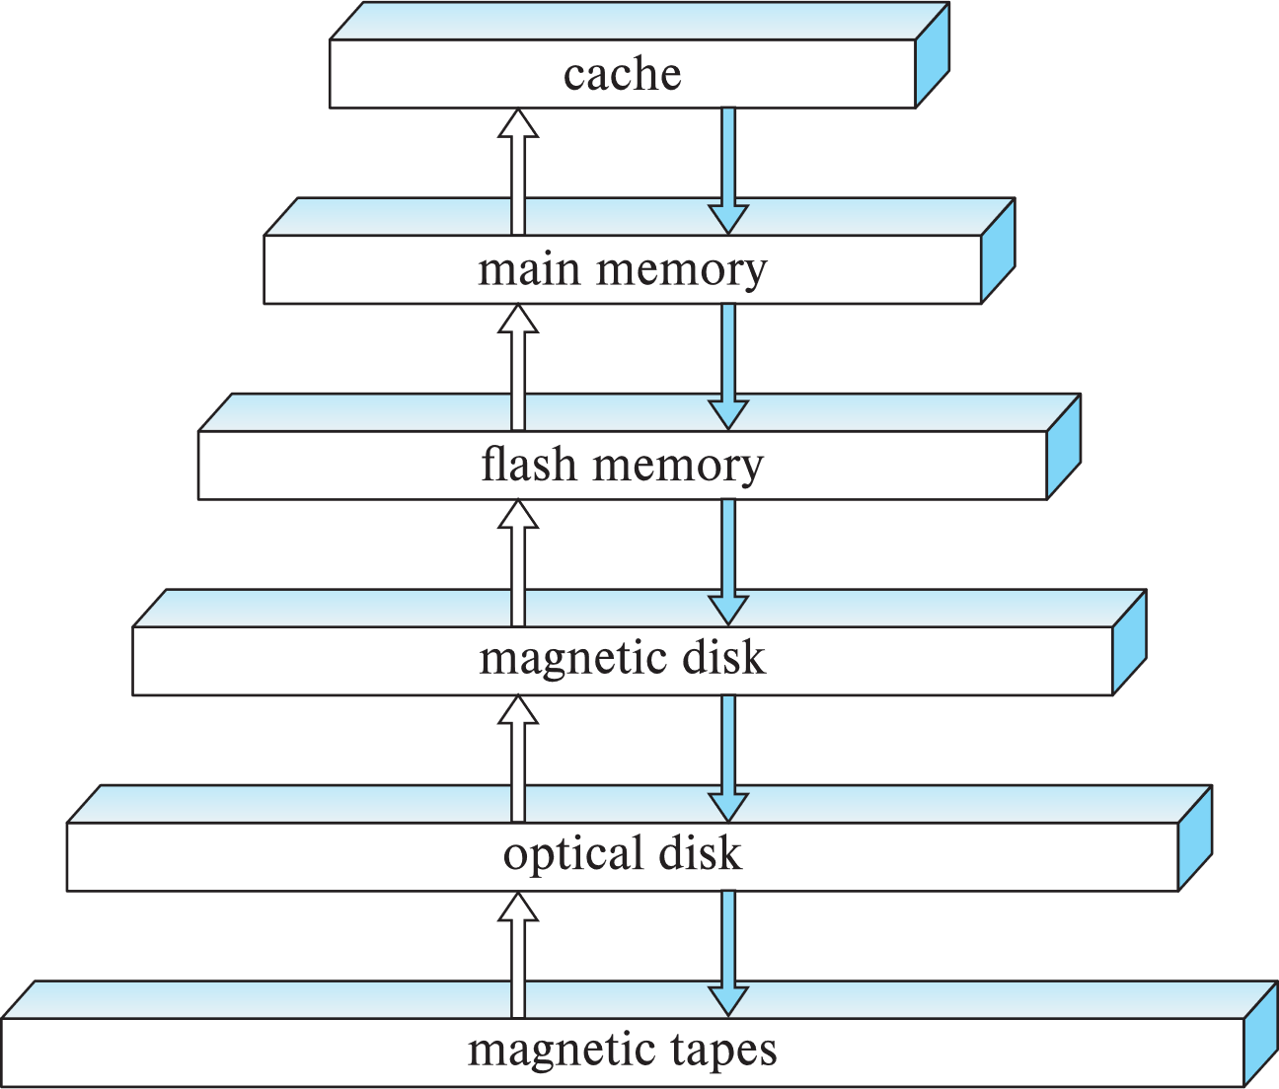
Storage Hierarchy
CPU

Slide 19
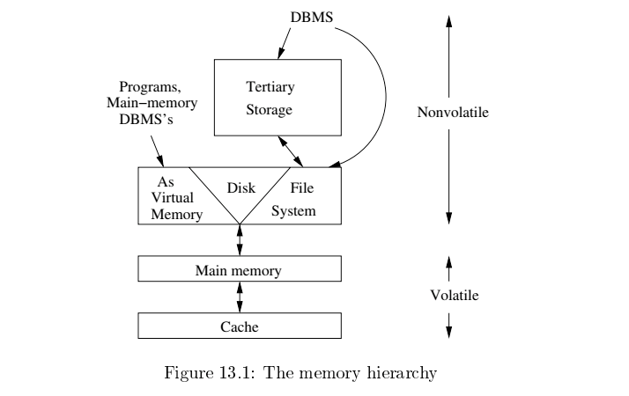
Memory Hierarchy
Slower
Cheaper
Unlimited
Faster
More expensive
Limited

Slide 20
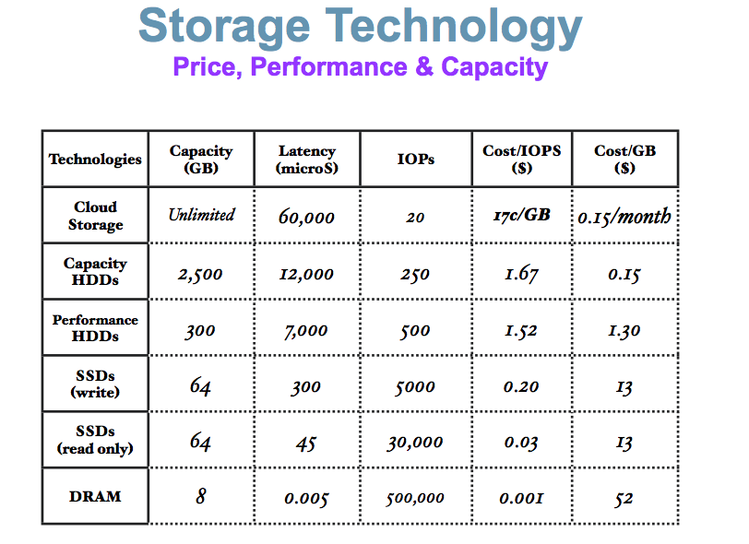
Memory Hierarchy (Very Old Numbers – Still Directionally Valid)
These numbers are ancient.
Looking for more modern numbers.
But, does give an idea of
Price
Performance
The general observation is that
Performance goes up 10X/level.
Price goes up 10x per level.
Note: One major change is improved price performance of SDD relative to HDD for large data.

Slide 21
Storage Hierarchy (Cont.)
primary storage: Fastest media but volatile (cache, main memory).
secondary storage: next level in hierarchy, non-volatile, moderately fast access time
Also called on-line storage
E.g., flash memory, magnetic disks
tertiary storage: lowest level in hierarchy, non-volatile, slow access time
also called off-line storage and used for archival storage
e.g., magnetic tape, optical storage
Magnetic tape
Sequential access, 1 to 12 TB capacity
A few drives with many tapes
Juke boxes with petabytes (1000’s of TB) of storage

Slide 22
Hard Disk Drive

Slide 23
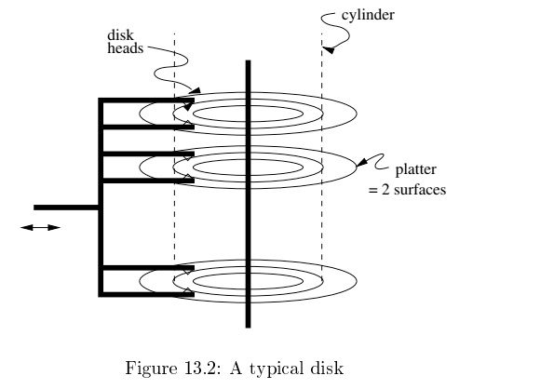
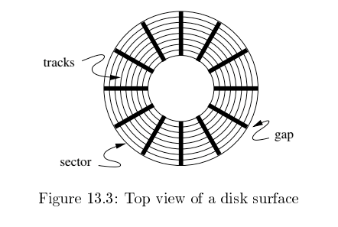
Disk Configuration
Components of disk I/O delay
Seek: Move head to cylinder/track.
Rotation: Wait for sector to get under head.
Transfer: Move data from disk to memory.
Database Systems: The Complete Book (2nd Edition) by Hector Garcia-Molina (Author), Jeffrey D. Ullman (Author), Jennifer Widom (Author)

Slide 24
Hard Disk versus Solid State Disk
Hard
Disk
Drive
Solid
State
Drive

Slide 25
Flash Storage
NOR flash vs NAND flash
NAND flash
used widely for storage, cheaper than NOR flash
requires page-at-a-time read (page: 512 bytes to 4 KB)
20 to 100 microseconds for a page read
Not much difference between sequential and random read
Page can only be written once
Must be erased to allow rewrite
Solid state disks
Use standard block-oriented disk interfaces, but store data on multiple flash storage devices internally
Transfer rate of up to 500 MB/sec using SATA, and up to 3 GB/sec using NVMe PCIe
Despite the radically different implementation, it has a disk oriented API.

Slide 26
Logical Block Addressing
Concept:
The unit of transfer from a “disk” to the computers memory is a “block. Blocks are usually relatively large, e.g. 16 KB, 32 KB, ... ...
A program that reads or write a single byte, requires the database engine (or file system) to read/write the entire block.
The address of a block in the entire space of blocks is:
(Device ID, Block ID)
Block ID is simple 0, 1, 2, ... ...
The disk controller and disk implementation translate the logical block address into the physical address of blocks.
The physical address changes over time for various reasons, e.g. performance optimization, internal HW failure, etc.

Slide 27
Logical/Physical Block Addressing
The mapping from LBA to physical block address can change over time.
Internal HW failure.
SSD writes in a funny way.
You have to erase before writing.
So, the SSD (for performance)
Writes to an empty block.
Erase the original block.
Performance optimization on HDD
Based on block access patterns.
Place blocks on cylinder/sector/head in a way to minimize:
Seek
Rotate
Read/Write N
Processor
Read/Write N
Mech Controller
Buffer

Slide 28
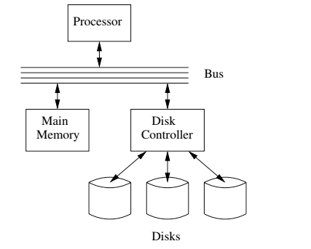
I/O Architecture
Large scale environments
The bus-controller connection is over some kind of network.
The disk controller is at the disks, and basically a “computer” with SW.
Network is either
Standard communication network, or
Highly optimized I/O network.
How we normally think of disks and I/O.

Slide 29
Magnetic Disks
Read-write head
Surface of platter divided into circular tracks
Over 50K-100K tracks per platter on typical hard disks
Each track is divided into sectors.
A sector is the smallest unit of data that can be read or written.
Sector size typically 512 bytes
Typical sectors per track: 500 to 1000 (on inner tracks) to 1000 to 2000 (on outer tracks)
To read/write a sector
disk arm swings to position head on right track
platter spins continually; data is read/written as sector passes under head
Head-disk assemblies
multiple disk platters on a single spindle (1 to 5 usually)
one head per platter, mounted on a common arm.
Cylinder i consists of i^{th} track of all the platters
Notes:
Mention: checksums, bad sector remapping

Slide 30
Magnetic Disks (Cont.)
Disk controller – interfaces between the computer system and the disk drive hardware.
accepts high-level commands to read or write a sector
initiates actions such as moving the disk arm to the right track and actually reading or writing the data
Computes and attaches checksums to each sector to verify that data is read back correctly
If data is corrupted, with very high probability stored checksum won’t match recomputed checksum
Ensures successful writing by reading back sector after writing it
Performs remapping of bad sectors

Slide 31
Performance Measures of Disks
Access time – the time it takes from when a read or write request is issued to when data transfer begins. Consists of:
Seek time – time it takes to reposition the arm over the correct track.
Average seek time is 1/2 the worst case seek time.
Would be 1/3 if all tracks had the same number of sectors, and we ignore the time to start and stop arm movement
4 to 10 milliseconds on typical disks
Rotational latency – time it takes for the sector to be accessed to appear under the head.
4 to 11 milliseconds on typical disks (5400 to 15000 r.p.m.)
Average latency is 1/2 of the above latency.
Overall latency is 5 to 20 msec depending on disk model
Data-transfer rate – the rate at which data can be retrieved from or stored to the disk.
25 to 200 MB per second max rate, lower for inner tracks

Slide 32
Performance Measures (Cont.)
Disk block is a logical unit for storage allocation and retrieval
4 to 16 kilobytes typically
Smaller blocks: more transfers from disk
Larger blocks: more space wasted due to partially filled blocks
Sequential access pattern
Successive requests are for successive disk blocks
Disk seek required only for first block
Random access pattern
Successive requests are for blocks that can be anywhere on disk
Each access requires a seek
Transfer rates are low since a lot of time is wasted in seeks
I/O operations per second (IOPS)
Number of random block reads that a disk can support per second
50 to 200 IOPS on current generation magnetic disks

Slide 33
Performance Measures (Cont.)
Mean time to failure (MTTF) – the average time the disk is expected to run continuously without any failure.
Typically 3 to 5 years
Probability of failure of new disks is quite low, corresponding to a “theoretical MTTF” of 500,000 to 1,200,000 hours for a new disk
E.g., an MTTF of 1,200,000 hours for a new disk means that given 1000 relatively new disks, on an average one will fail every 1200 hours
MTTF decreases as disk ages

Slide 34
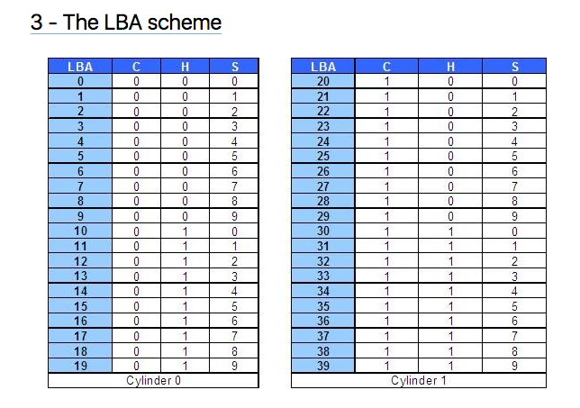
Logical Block Addressing (https://gerardnico.com/wiki/data_storage/lba)
CHS addresses can be converted to LBA addresses using the following formula:
LBA = (( C x HPC ) + H ) x SPT + S – 1
where,
C, H and S are the cylinder number, the head number, and the sector number
LBA is the logical block address
HPC is the number of heads per cylinder
SPT is the number of sectors per track
Devices have configuration and metadata APIs that allow storage manager to
Map between LBA and CHS
To optimize block placement
Based on access patterns, statistics, data schema, etc.

Slide 35
I/O Architecture
Redundant Array of Independent Disks (RAID)

Slide 36
RAID (https://en.wikipedia.org/wiki/RAID)
“RAID (redundant array of independent disks) is a data storage virtualization technology that combines multiple physical disk drive components into a single logical unit for the purposes of data redundancy, performance improvement, or both. (…)
RAID 0 consists of striping, without mirroring or parity. (…)
RAID 1 consists of data mirroring, without parity or striping. (…)
RAID 2 consists of bit-level striping with dedicated Hamming-code parity. (…)
RAID 3 consists of byte-level striping with dedicated parity. (…)
RAID 4 consists of block-level striping with dedicated parity. (…)
RAID 5 consists of block-level striping with distributed parity. (…)
RAID 6 consists of block-level striping with double distributed parity. (…)
Nested RAID
RAID 0+1: creates two stripes and mirrors them. (…)
RAID 1+0: creates a striped set from a series of mirrored drives. (…)
JBOD RAID N+N: With JBOD (just a bunch of disks), (…)”

Slide 37
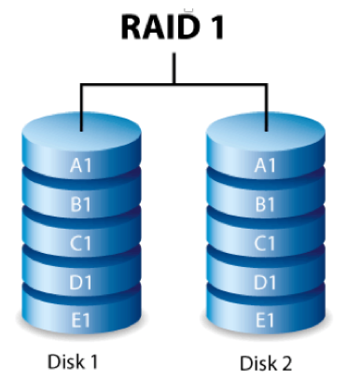
RAID-0 and RAID-1
Two physical disks make one single, logical fast disk
Two physical disks make one single, logical reliable disk
Single “Fast” Disk
Single “Reliable” Disk

Slide 38
Mixed RAID Modes
Stripe
And
Mirror

Slide 39
RAID-5
One Big Logical Disk
Improved performance through parallelism
Rotation/seek
Transfer
Availability uses parity blocks
Suppose I have 4 different data blocks on the logical drive A: A1, A2, A3, A4.
Parity function: Ap = P(A1,A2,A3,A4)
Recovery function: A2=R(Ap,A1,A3,A4)
During normal operations:
Read processing simply retrieves block.
Write processing of A2 updates A2 and Ap
If an individual disk fails, the RAID
Read
Continues to function for reads on non-missing blocks.
Implements read on missing block by recalculating value.
Write
Updates block and parity block for non-missing blocks.
Computes missing block, and calculates parity based on old and new value.
Over time
“Hot Swap” the failed disk.
Rebuild the missing data from values and parity.
Is actually 5 smaller “logical” disks.
A
B
C
D
E
Logical disk data spread over 5 physical disks.

Slide 40
Very Simple Parity Example
Even-Odd Parity
b[i] is an array of bits (0 or 1)
P(b[i]) =
0 is an even number of bits = 1. {P([0,1,1,0,1,1])= 0
1 if an odd number of bits = 1. {P(0,0,1,0,1,1]= 1
Given an array with one missing bit and the parity bit, I can re-compute the missing bit.
Case 1: [0,?,1,0,1,1] has P=0. There must be an EVEN number of ones and ?=1.
Case 2: [0,?,1,0,1,1] has P=1. There must be an ODD number of ones and ?=0.
Block Parity applies this to a set of blocks bitwise
A1=[0,1,0,0,1,1]
A2=[1,1,1,0,0,0]
A3=[0,0,0,1,0,1]
Pa=[1,0,1,1,1,0]
➔
If I am missing a block and have the parity block, I can re-compute the missing block bitwise from remaining blocks and parity block.

Slide 41
Data Storage Structures (Database Systems Concepts, V7, Ch. 13)
41 | Introduction to Databases (S21): Lecture 8: No SQL, DB Disks and Files © Donald F. Ferguson, 2020

Slide 42
File Organization
The database is stored as a collection of files. Each file is a sequence of records. A record is a sequence of fields.
One approach
Assume record size is fixed
Each file has records of one particular type only
Different files are used for different relations
This case is easiest to implement; will consider variable length records later
We assume that records are smaller than a disk block
.

Slide 43
Terminology
A tuple in a relation maps to a record. Records may be
Fixed length
Variable length
Variable format (which we will see in Neo4J, DynamoDB, etc).
A block
Is the unit of transfer between disks and memory (buffer pools).
Contains multiple records, usually but not always from the same relation.
The database address space contains
All of the blocks and records that the database manages
Including blocks/records containing data
And blocks/records containing free space.

Slide 44
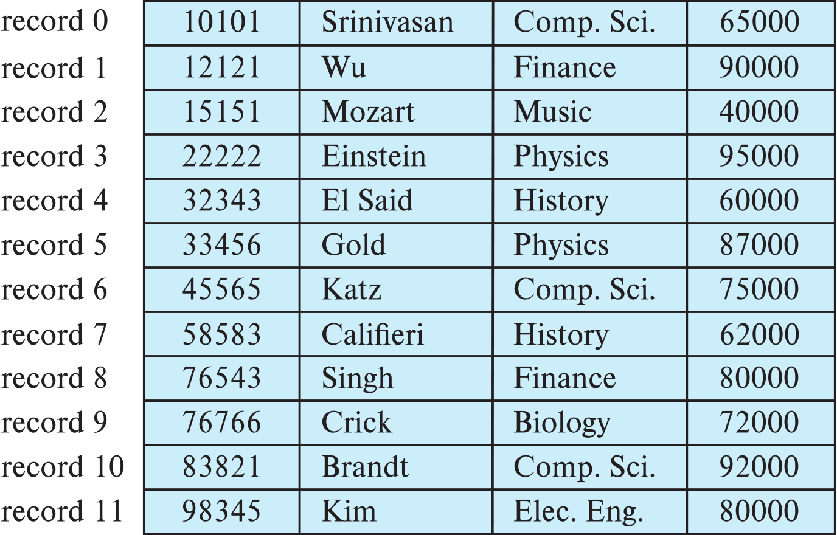
Fixed-Length Records
Simple approach:
Store record i starting from byte n ∗ (i – 1), where n is the size of each record.
Record access is simple but records may cross blocks
Modification: do not allow records to cross block boundaries

Slide 45
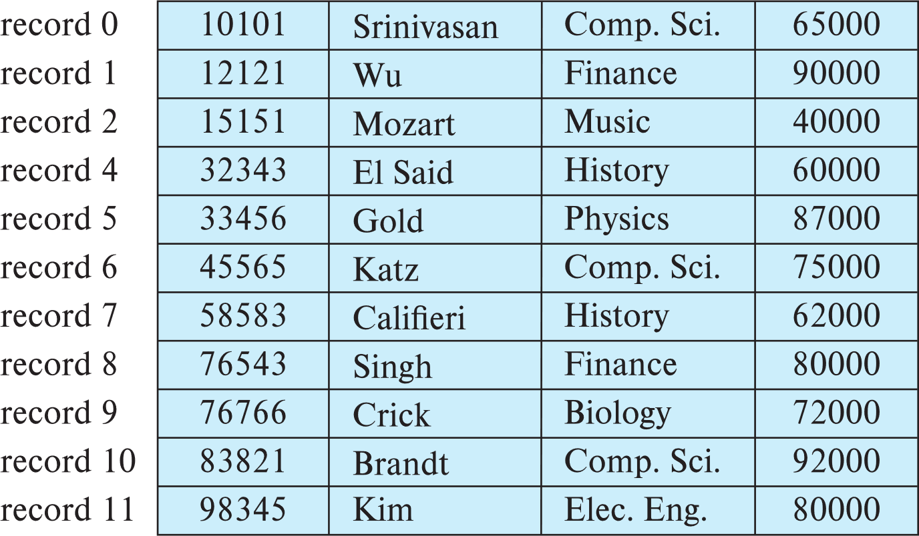
Fixed-Length Records
Deletion of record i: alternatives:
move records i + 1, . . ., n to i, . . . , n – 1
move record n to i
do not move records, but link all free records on a free list
Record 3 deleted

Slide 46
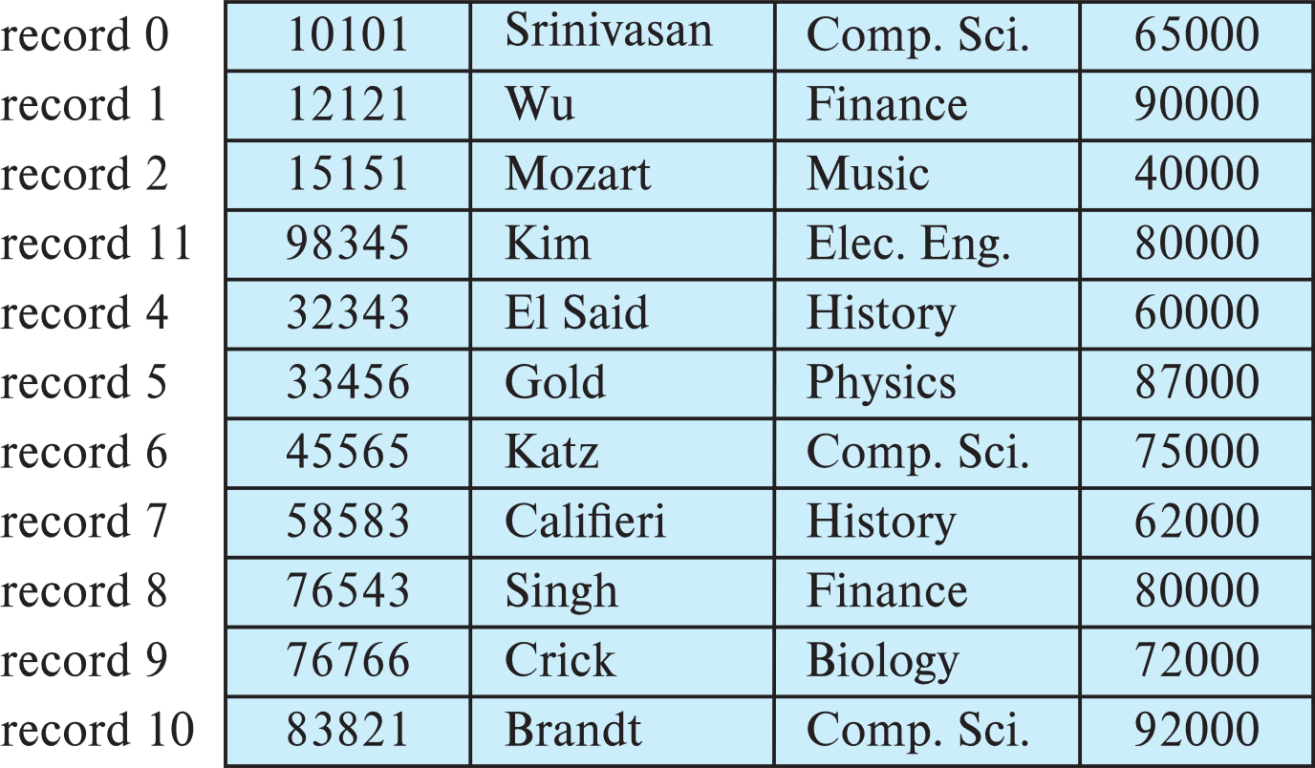
Fixed-Length Records
Deletion of record i: alternatives:
move records i + 1, . . ., n to i, . . . , n – 1
move record n to i
do not move records, but link all free records on a free list
Record 3 deleted and replaced by record 11

Slide 47
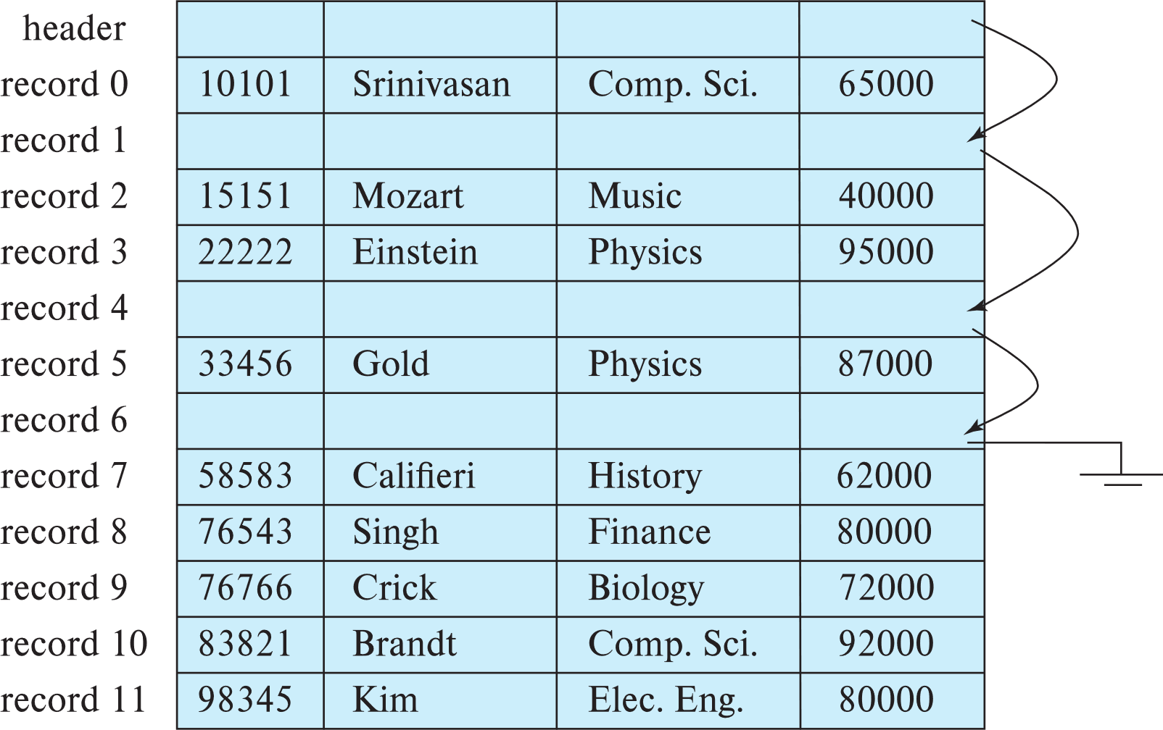
Fixed-Length Records
Deletion of record i: alternatives:
move records i + 1, . . ., n to i, . . . , n – 1
move record n to i
do not move records, but link all free records on a free list

Slide 48
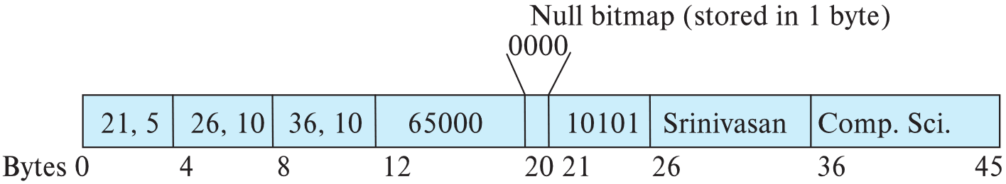
Variable-Length Records
Variable-length records arise in database systems in several ways:
Storage of multiple record types in a file.
Record types that allow variable lengths for one or more fields such as strings (varchar)
Record types that allow repeating fields (used in some older data models).
Attributes are stored in order
Variable length attributes represented by fixed size (offset, length), with actual data stored after all fixed length attributes
Null values represented by null-value bitmap

Slide 49
Variable-Length Records: Slotted Page Structure
Slotted page header contains:
number of record entries
end of free space in the block
location and size of each record
Records can be moved around within a page to keep them contiguous with no empty space between them; entry in the header must be updated.
Pointers should not point directly to record — instead they should point to the entry for the record in header.

Slide 50
Storing Large Objects
E.g., blob/clob types
Records must be smaller than pages
Alternatives:
Store as files in file systems
Store as files managed by database
Break into pieces and store in multiple tuples in separate relation
PostgreSQL TOAST

Slide 51
Organization of Records in Files
Heap – record can be placed anywhere in the file where there is space
Sequential – store records in sequential order, based on the value of the search key of each record
In a multitable clustering file organization records of several different relations can be stored in the same file
Motivation: store related records on the same block to minimize I/O
B⁺-tree file organization
Ordered storage even with inserts/deletes
More on this in Chapter 14
Hashing – a hash function computed on search key; the result specifies in which block of the file the record should be placed
More on this in Chapter 14

Slide 52
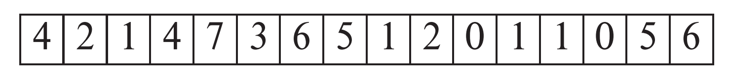
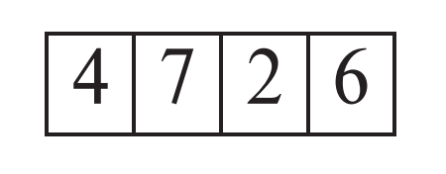
Heap File Organization
Records can be placed anywhere in the file where there is free space
Records usually do not move once allocated
Important to be able to efficiently find free space within file
Free-space map
Array with 1 entry per block. Each entry is a few bits to a byte, and records fraction of block that is free
In example below, 3 bits per block, value divided by 8 indicates fraction of block that is free
Can have second-level free-space map
In example below, each entry stores maximum from 4 entries of first-level free-space map
Free space map written to disk periodically, OK to have wrong (old) values for some entries (will be detected and fixed)

Slide 53
Sequential File Organization
Suitable for applications that require sequential processing of the entire file
The records in the file are ordered by a search-key

Slide 54
Sequential File Organization (Cont.)
Deletion – use pointer chains
Insertion –locate the position where the record is to be inserted
if there is free space insert there
if no free space, insert the record in an overflow block
In either case, pointer chain must be updated
Need to reorganize the file from time to time to restore sequential order

Slide 55
Partitioning
Table partitioning: Records in a relation can be partitioned into smaller relations that are stored separately
E.g., transaction relation may be partitioned into transaction_2018, transaction_2019, etc.
Queries written on transaction must access records in all partitions
Unless query has a selection such as year=2019, in which case only one partition in needed
Partitioning
Reduces costs of some operations such as free space management
Allows different partitions to be stored on different storage devices
E.g., transaction partition for current year on SSD, for older years on magnetic disk

Slide 56
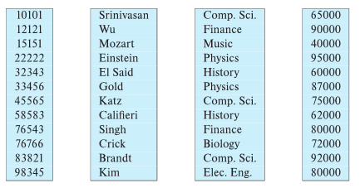
Column-Oriented Storage
Also known as columnar representation
Store each attribute of a relation separately
Example

Slide 57
Columnar (Relational) Database (https://www.dbbest.com/blog/column-oriented-database-technologies/)
Columnar and Row are both
Relational
Support SQL operations
But differ in data storage
Row keeps row data together in blocks.
Columnar keys column data together in blocks.
This determines performance for different types of query, e.g.
Columnar is extremely powerful for BI scenarios
Aggregation ops, e.g. SUM, AVG
PROJECT (do not load all of the row) to get a few columns
Row is powerful for OLTP. Transaction typically create and retrieve
One row at a time
All the columns of a single row.

Slide 58
Columnar Representation
Benefits:
Reduced IO if only some attributes are accessed
Improved CPU cache performance
Improved compression
Vector processing on modern CPU architectures
Drawbacks
Cost of tuple reconstruction from columnar representation
Cost of tuple deletion and update
Cost of decompression
Columnar representation found to be more efficient for decision support than row-oriented representation
Traditional row-oriented representation preferable for transaction processing
Some databases support both representations
Called hybrid row/column stores

Slide 59
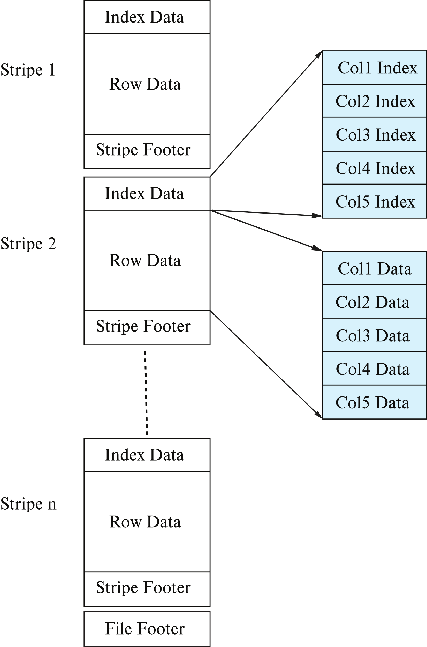
Columnar File Representation
ORC and Parquet: file formats with columnar storage inside file
Very popular for big-data applications
Orc file format shown on right:

Slide 60
Memory and Buffer Pools
60 | Introduction to Databases (S21): Lecture 8: No SQL, DB Disks and Files © Donald F. Ferguson, 2020

Slide 61
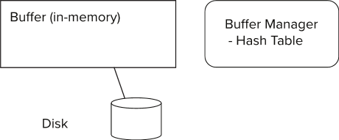
Storage Access
Blocks are units of both storage allocation and data transfer.
Database system seeks to minimize the number of block transfers between the disk and memory. We can reduce the number of disk accesses by keeping as many blocks as possible in main memory.
Buffer – portion of main memory available to store copies of disk blocks.
Buffer manager – subsystem responsible for allocating buffer space in main memory.
Notes:
61

Slide 62
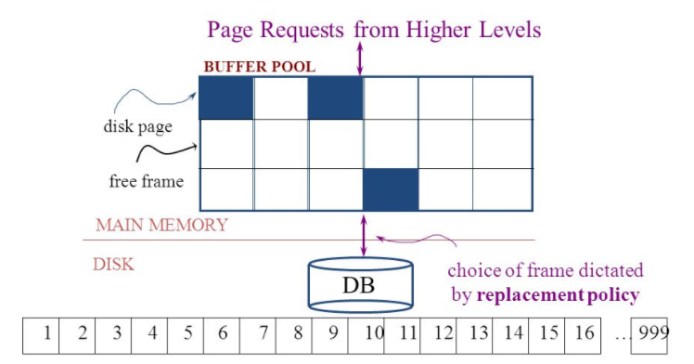
The Logical Concept
The DBMS and queries can only manipulate in-memory blocks and records.
A very, very, very small fraction of all blocks fit in memory.

Slide 63
Buffer Manager
Programs call on the buffer manager when they need a block from disk.
If the block is already in the buffer, buffer manager returns the address of the block in main memory
If the block is not in the buffer, the buffer manager
Allocates space in the buffer for the block
Replacing (throwing out) some other block, if required, to make space for the new block.
Replaced block written back to disk only if it was modified since the most recent time that it was written to/fetched from the disk.
Reads the block from the disk to the buffer, and returns the address of the block in main memory to requester.
Notes:
63

Slide 64
Buffer Manager
Buffer replacement strategy (details coming up!)
Pinned block: memory block that is not allowed to be written back to disk
Pin done before reading/writing data from a block
Unpin done when read /write is complete
Multiple concurrent pin/unpin operations possible
Keep a pin count, buffer block can be evicted only if pin count = 0
Shared and exclusive locks on buffer
Needed to prevent concurrent operations from reading page contents as they are moved/reorganized, and to ensure only one move/reorganize at a time
Readers get shared lock, updates to a block require exclusive lock
Locking rules:
Only one process can get exclusive lock at a time
Shared lock cannot be concurrently with exclusive lock
Multiple processes may be given shared lock concurrently

Slide 65
Buffer-Replacement Policies
Most operating systems replace the block least recently used (LRU strategy)
Idea behind LRU – use past pattern of block references as a predictor of future references
LRU can be bad for some queries
Queries have well-defined access patterns (such as sequential scans), and a database system can use the information in a user’s query to predict future references
Mixed strategy with hints on replacement strategy provided by the query optimizer is preferable
Example of bad access pattern for LRU: when computing the join of 2 relations r and s by a nested loops
for each tuple tr of r do for each tuple ts of s do if the tuples tr and ts match …
Notes:
65

Slide 66
Buffer-Replacement Policies (Cont.)
Toss-immediate strategy – frees the space occupied by a block as soon as the final tuple of that block has been processed
Most recently used (MRU) strategy – system must pin the block currently being processed. After the final tuple of that block has been processed, the block is unpinned, and it becomes the most recently used block.
Buffer manager can use statistical information regarding the probability that a request will reference a particular relation
E.g., the data dictionary is frequently accessed. Heuristic: keep data-dictionary blocks in main memory buffer
Operating system or buffer manager may reorder writes
Can lead to corruption of data structures on disk
E.g., linked list of blocks with missing block on disk
File systems perform consistency check to detect such situations
Careful ordering of writes can avoid many such problems
Notes:
66

Slide 67
Replacement Policy
The replacement policy is one of the most important factors in database management system implementation and configuration.
A very simple, introductory explanation is (https://en.wikipedia.org/wiki/Cache_replacement_policies).
There are a lot of possible policies.
The most efficient caching algorithm would be to always discard the information that will not be needed for the longest time in the future. This optimal result is referred to as Bélády's optimal algorithm/simply optimal replacement policy or the clairvoyant algorithm.
All implementable policies are an attempt to approximate knowledge of the future based on knowledge of the past.
Least Recently Used is based on the simplest assumption
The information that will not be needed for the longest time.
Is the information that has not been accessed for the longest time.

Slide 68
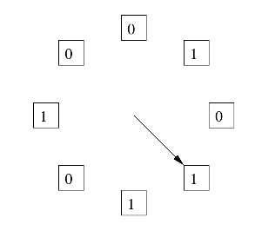
The “Clock Algorithm”
LRU is (perceived to be) expensive
Maintain timestamp for each block.
Update and resort blocks on access.
The “Clock Algorithm” is a less expensive approximation.
Arrange the frames (places blocks can go) into a logical circle like the seconds on a clock face.
Each frame is marked 0 or 1.
Set to 1 when block added to frame.
Or when application accesses a block in frame.
Replacement choice
Sweep second hand clockwise one frame at a time.
If bit is 0, choose for replacement.
If bit is 1, set bit to zero and go to next frame.
The basic idea is. On a clock face
If the second hand is currently at 27 seconds.
The 28 second tick mark is “the least recently touched mark.”

Slide 69
Replacement Algorithm
The algorithms are more sophisticated in the real world, e.g.
“Scans” are common, e.g. go through a large query result in order (will be more clear when discussing cursors).
The engine knows the current position in the result set.
Uses the sort order to determine which records will be accessed soon.
Tags those blocks as not replaceable.
(A form of clairvoyance).
Not all users/applications are equally “important.”
Classify users/applications into priority 1, 2 and 3.
Sub-allocate the buffer pool into pools P1, P2 and P3.
Apply LRU within pools and adjust pool sizes based on relative importance.
This prevents
A high access rate, low-priority application from taking up a lot of frames
Result in low access, high priority applications not getting buffer hits.

Slide 70
Optimization of Disk Block Access (Cont.)
Buffer managers support forced output of blocks for the purpose of recovery (more in Chapter 19)
Nonvolatile write buffers speed up disk writes by writing blocks to a non-volatile RAM or flash buffer immediately
Writes can be reordered to minimize disk arm movement
Log disk – a disk devoted to writing a sequential log of block updates
Used exactly like nonvolatile RAM
Write to log disk is very fast since no seeks are required
Journaling file systems write data in-order to NV-RAM or log disk
Reordering without journaling: risk of corruption of file system data

Slide 71
NoSQL
71 | Introduction to Databases (S21): Lecture 8: No SQL, DB Disks and Files © Donald F. Ferguson, 2020

Slide 72
Overview (I) (https://en.wikipedia.org/wiki/NoSQL)
A NoSQL (originally referring to "non SQL" or "non relational")^{[1]} database provides a mechanism for storage and retrieval of data that is modeled in means other than the tabular relations used in relational databases. Such databases have existed since the late 1960s, but did not obtain the "NoSQL" moniker until a surge of popularity in the early twenty-first century,^{[2]} triggered by the needs of Web 2.0 companies such as Facebook, Google, and Amazon.com.^{[3][4][5]} NoSQL databases are increasingly used in big data and real-time web applications.^{[6]} NoSQL systems are also sometimes called "Not only SQL" to emphasize that they may support SQL-like query languages.^{[7][8]}
Motivations for this approach include: simplicity of design, simpler "horizontal" scaling to clusters of machines (which is a problem for relational databases),^{[2]} and finer control over availability. The data structures used by NoSQL databases (e.g. key-value, wide column, graph, or document) are different from those used by default in relational databases, making some operations faster in NoSQL. The particular suitability of a given NoSQL database depends on the problem it must solve. Sometimes the data structures used by NoSQL databases are also viewed as "more flexible" than relational database tables.^{[9]}

Slide 73
Overview (I) (https://en.wikipedia.org/wiki/NoSQL)
Many NoSQL stores compromise consistency (in the sense of the CAP theorem) in favor of availability, partition tolerance, and speed. Barriers to the greater adoption of NoSQL stores include the use of low-level query languages (instead of SQL, for instance the lack of ability to perform ad-hoc joins across tables), lack of standardized interfaces, and huge previous investments in existing relational databases.^{[10]} Most NoSQL stores lack true ACID transactions, … …
Instead, most NoSQL databases offer a concept of "eventual consistency" in which database changes are propagated to all nodes "eventually" (typically within milliseconds) so queries for data might not return updated data immediately or might result in reading data that is not accurate, a problem known as stale reads.^{[11]} Additionally, some NoSQL systems may exhibit lost writes and other forms of data loss.^{[12]} Fortunately, some NoSQL systems provide concepts such as write-ahead logging to avoid data loss.^{[13]} For distributed transaction processing across multiple databases, data consistency is an even bigger challenge that is difficult for both NoSQL and relational databases. Even current relational databases "do not allow referential integrity constraints to span databases."^{[14]}

Slide 74
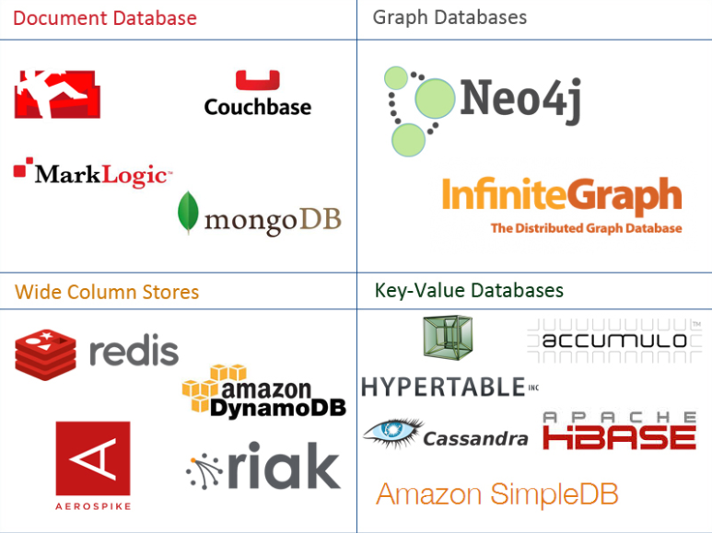
One Taxonomy

Slide 75
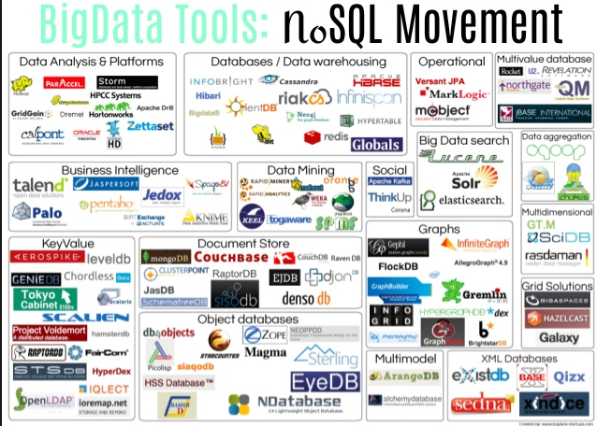
Another Taxonomy

Slide 76
Use Cases
Motivations
Massive write performance.
Fast key value look ups.
Flexible schema and data types.
No single point of failure.
Fast prototyping and development.
Out of the box scalability.
Easy maintenance.
What is wrong with SQL/Relational?
Nothing. One size fits all? Not really.
Impedance mismatch. – Object Relational Mapping doesn’t work quite well.
Rigid schema design.
Harder to scale.
Replication.
Joins across multiple nodes? Hard.
How does RDMS handle data growth? Hard.
Need for a DBA.
Many programmers are already familiar with it.
Transactions and ACID make development easy.
Lots of tools to use.

Slide 77
Graph Databases
77 | Introduction to Databases (S21): Lecture 8: No SQL, DB Disks and Files © Donald F. Ferguson, 2020

Slide 78
Graph Database
Exactly what it sounds like
Two core types
Node
Edge (link)
Nodes and Edges have
Label(s) = “Kind”
Properties (free form)
Query is of the form
p1(n)-p2(e)-p3(m)
n, m are nodes; e is an edge
p1, p2, p3 are predicates on labels
N->R->M

Slide 79
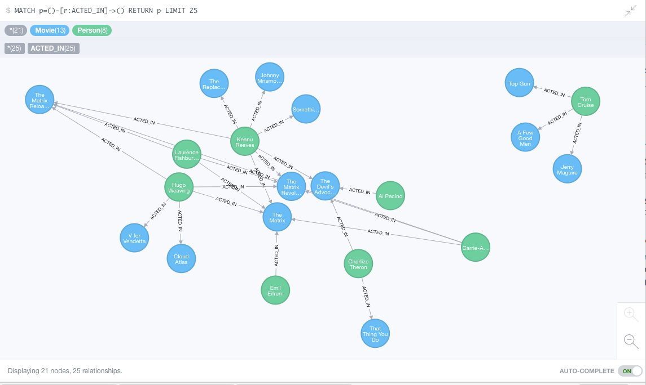
Neo4J Graph Query

Slide 80
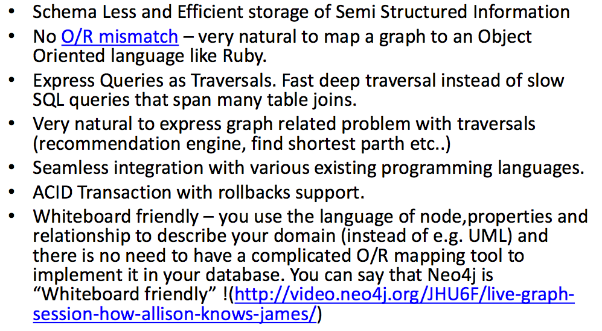
Why Graph Databases?

Slide 81
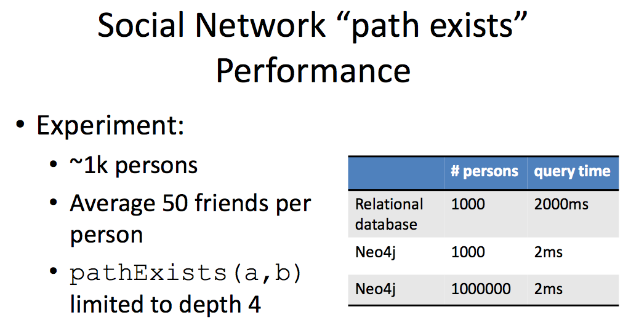
Graph databases are
Extremely fast for some queries and data models.
Implement a language that vastly simplifies writing queries.

Slide 82
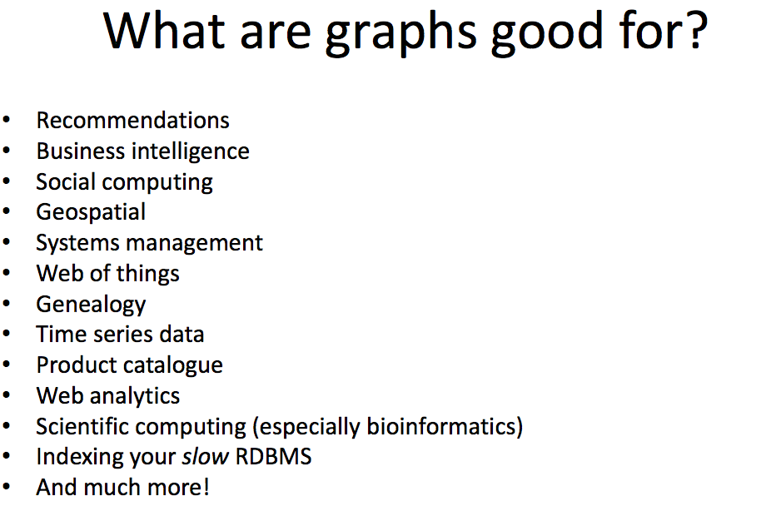

Slide 83
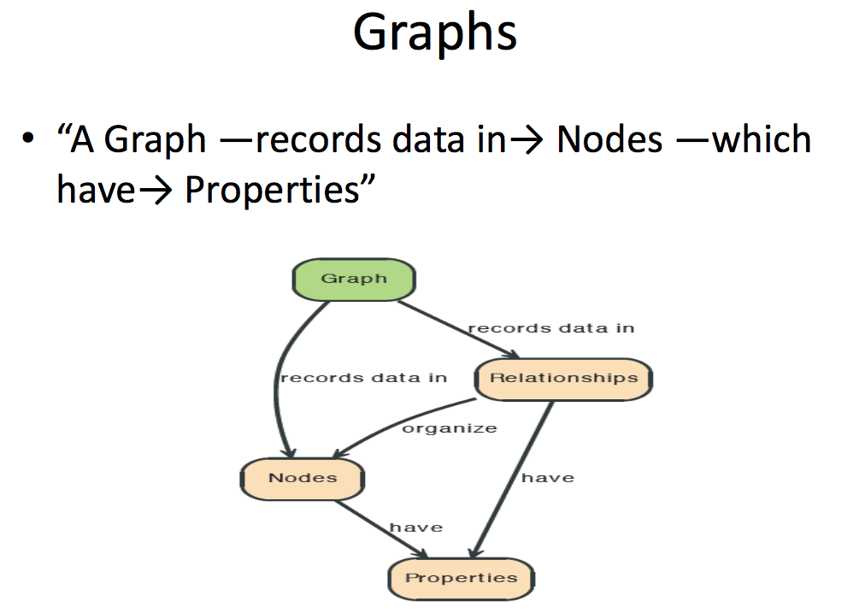

Slide 84
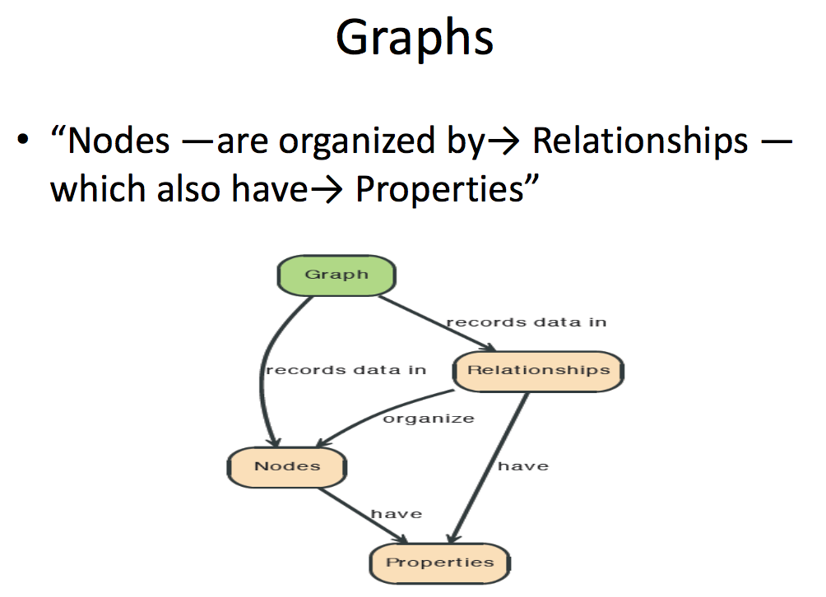

Slide 85
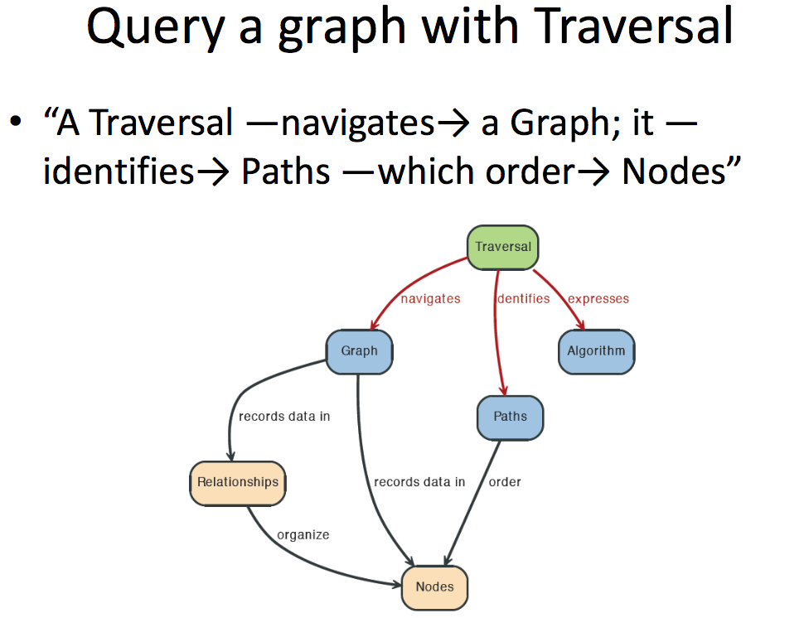

Slide 86
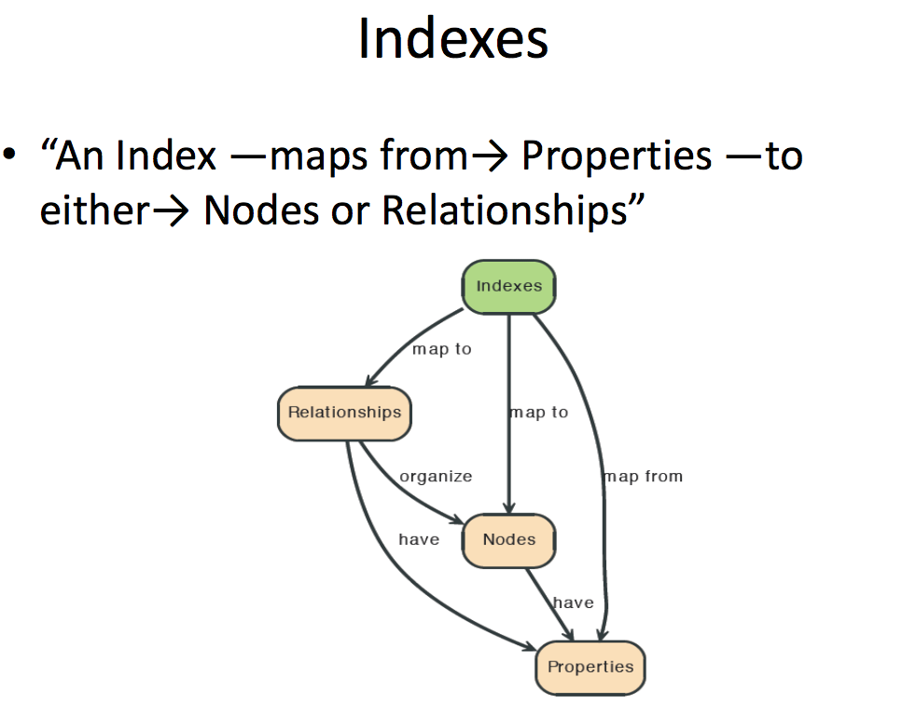

Slide 87
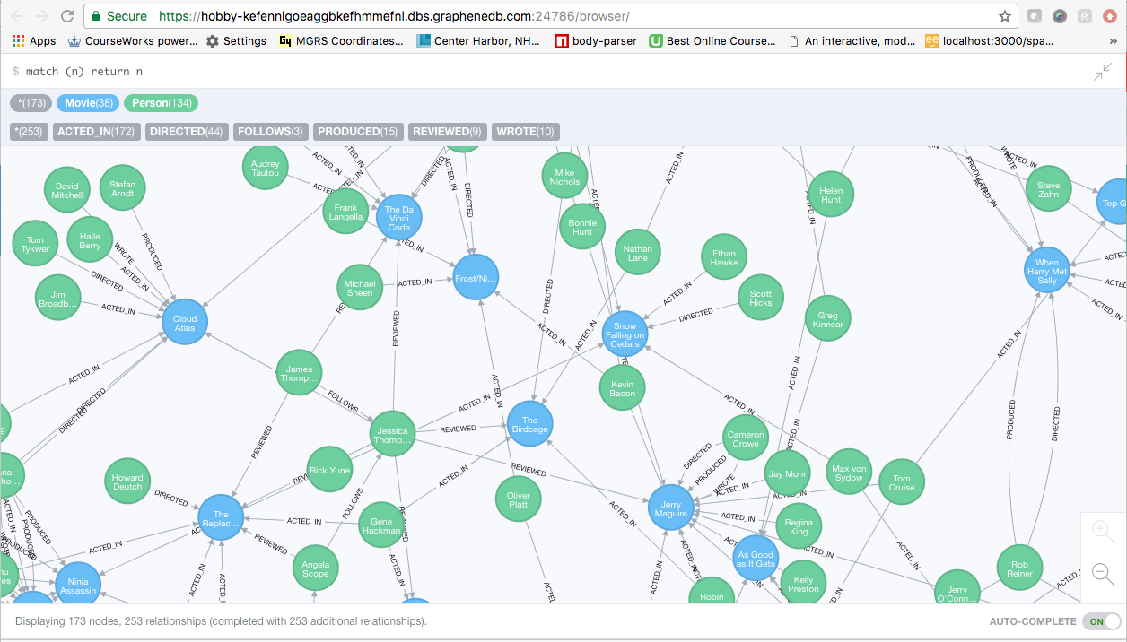
A Graph Database (Sample)

Slide 88
Neo4J Graph Query
Who acted in which movies?

Slide 89
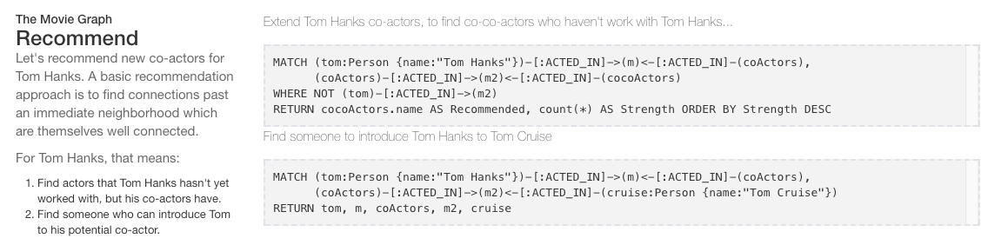
Big Deal. That is just a JOIN.
Yup. But that is simple.
Try writing the queries below in SQL.

Slide 90
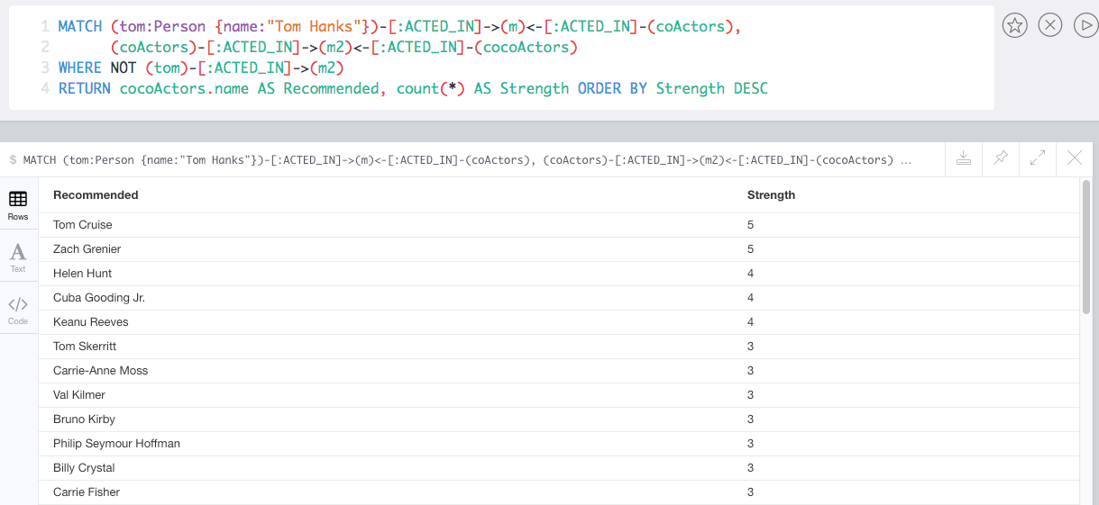
Recommend

Slide 91
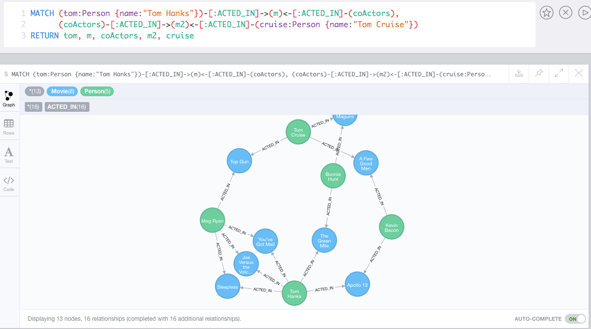
Which actors have worked with both Tom Hanks and
Tom Cruise?

Slide 92
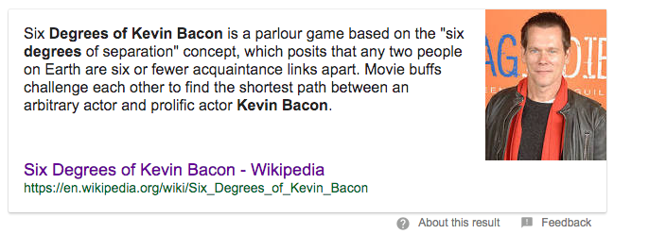
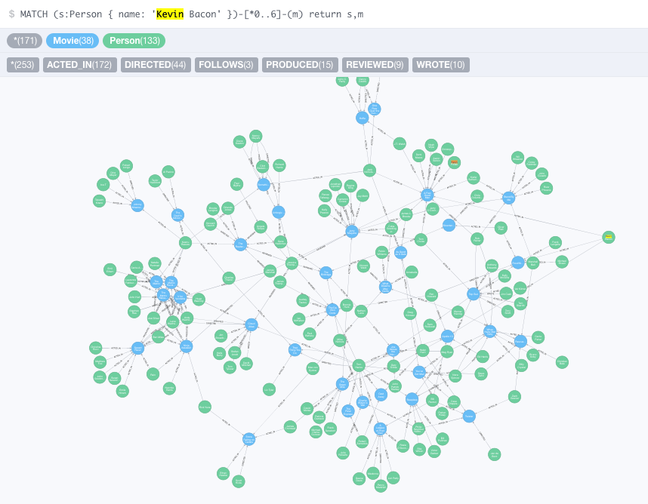


Slide 93
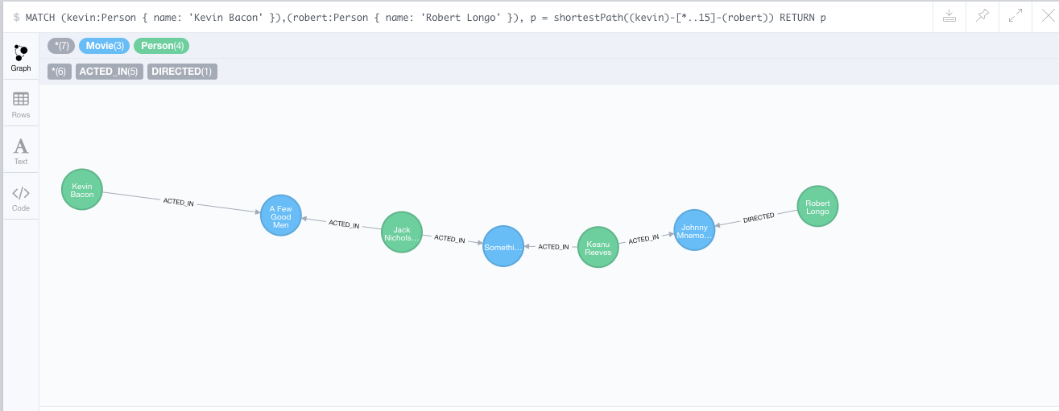
How do you get from Kevin Bacon to
Robert Longo?

Slide 94
Take a Test Drive Neo4j
94 | Introduction to Databases (S21): Lecture 8: No SQL, DB Disks and Files © Donald F. Ferguson, 2020

Slide 95
HW3 (Project)
95 | Introduction to Databases (S21): Lecture 8: No SQL, DB Disks and Files © Donald F. Ferguson, 2020

Slide 96
Pretend to Play Fantasy Baseball
Project for the two tracks will be a simple fantasy baseball solution.
“Fantasy baseball is a game in which people manage rosters of league baseball players, either online or in a physical location, using fictional fantasy baseball team names. The participants compete against one another using those players' real-life statistics to score points.”
My solution will have two subsystems:
Analysis system:
Read only data that enables people to select players based on performance, and to estimate the performance of their fantasy team.
Event based update system that changes analysis data based on new data.
Operational system that manages create, retrieve update, delete, etc. of their fantasy teams and leagues.
INSERT, UPDATE, DELETE primarily apply to the operational system.

Slide 97


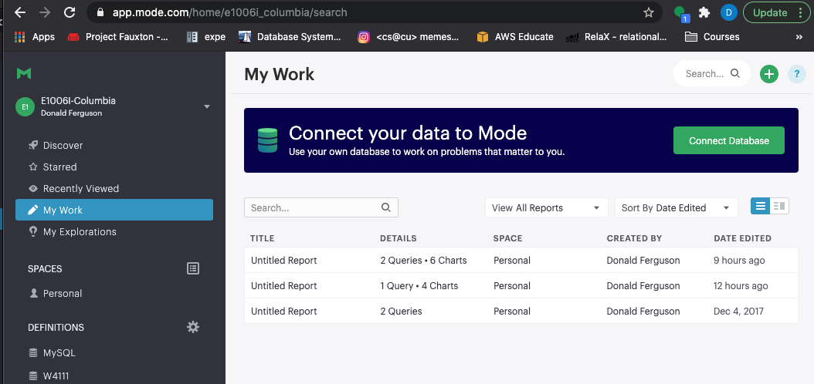

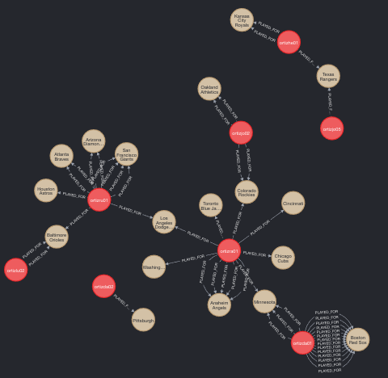
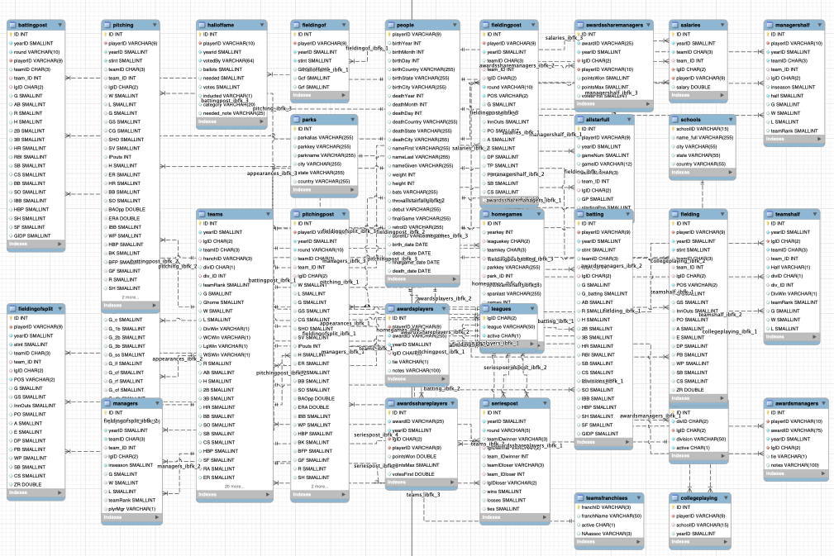
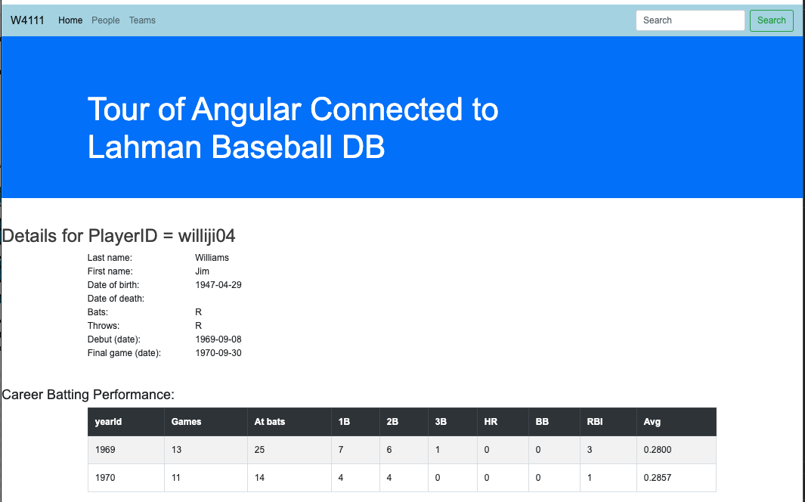
Target Application/Project(s) – Reminder (Lecture 1)
Data Insight Service
Data Lake
Web Application
Social Network Service
DB Access Service
Core Data Service
Comment Discussion Service

Slide 98
Target Application/Project – Reminder (Lecture 1)
That diagram was pretty confusing.
Basically, what it comes down to is that there will be major subsystems:
Interactive web application for viewing, navigating and updating data. The updates have to preserve semantic constraints and correctness.
A decision support warehouse/lake that allows us to explore data and get insights.
Programming and non-programming tracks will get experience with both, but
Non-programming track focuses on data engineering needed to produce (2).
Programming track will focus on (1).
We will use is fantasy baseball because:
It has aspects and tasks interesting to both tracks.
We have an existing data set that we have been using.
There are interesting additional sources of data and use cases.

Slide 99
Operational System (Web Application)
99 | COMS W4111_002_2021_1: Lecture 7: ER, Apps, SQL, Projects © Donald F. Ferguson, 2021

Slide 100
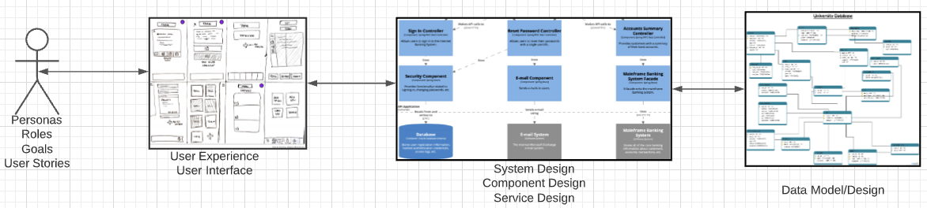
Problem Statement – Modified (Lecture 1 Reminder)
We must build a system that supports ... ... operations in a ... ...
We will design, develop, test and deploy the system iteratively and continuously.
There are four core domains.
The processes are iterative, with continuous extension and details.
We will start implementing various user stories. Implementation requires:
Web UI
Paths
Data model and operations.
In this course,
We focus on the data dimension.
We will get some insight into the other dimensions.

Slide 101
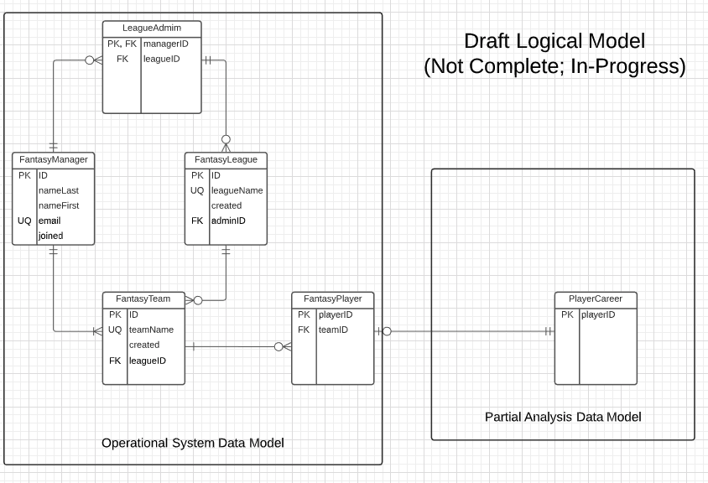
In-Progress Operational System Data Model

Slide 102
Web Application – Operational System
Lahman’s Baseball DB
Fantasy Baseball DB

Slide 103
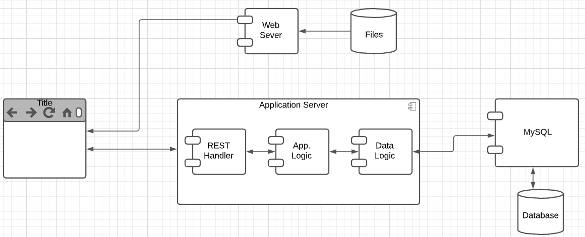
User Story
“In software development and product management, a user story is an informal, natural language description of one or more features of a software system. User stories are often written from the perspective of an end user or user of a system. ” (https://en.wikipedia.org/wiki/User_story)
Example user stories that I need to implement for the operational system:
”As a fantasy team manager, I want to search for players based on career stats.”
“As a fantasy team manager, I want to add a player to my fantasy team.
etc.
I need to implement:
UI
Application logic
Database tables.

Slide 104
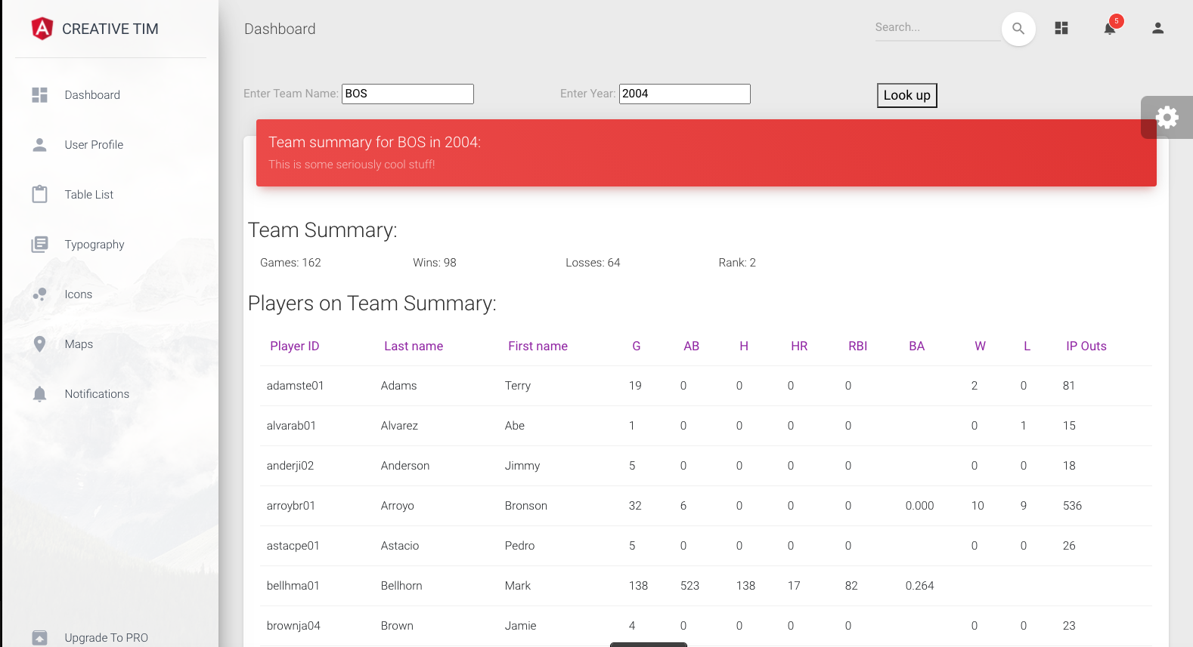
Simple Example
Web Application
MySQL
Two HTTP/REST calls:
GET /api/team_summary?team_id=BOS&year_id=2004
GET /api/teams?teamID=BOS&yearID=2004
Two SQL Queriess:
SELECT to Teams table.
SELECT to team_summary, which is a view. We cover views later.
“As a baseball fan, I want to enter a teamID and yearID and see:
Team wins and losses.
Summary of player performance for players on the team and year.”
Built:
Dashboard page.
REST handlers and application logic.
Database view.
Tracks will build:
Programming: Mix of CRUD and dashboard.
Non-programming: Dashboards, Data transformation.
Will see more details as we move forward.

Slide 105
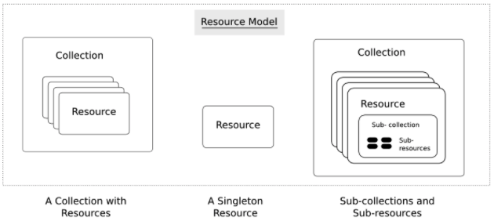
Simple Example – Fantasy Team Resource
https://restful-api-design.readthedocs.io/en/latest/resources.html
Interaction flow is right-to-left in this diagram.
Resources: (https://restful-api-design.readthedocs.io/en/latest/resources.html)
The fundamental concept in any RESTful API is the resource. A resource is an object with a type, associated data, relationships to other resources, and a set of methods that operate on it.
... ... information that describes available resources types, their behavior, and their relationships the resource model of an API. The resource model can be viewed as the RESTful mapping of the application data model.
APIs:
... ... APIs expose functionality of an application or service that exists independently of the API. (DFF comment – the data)
Understanding enough of the important details of the application for which an API is to be created, so that an informed decision can be made as to what functionality needs to be exposed ... ...
Modeling this functionality in an API that addresses all use cases that come up in the real world ... ...

Slide 106

CRUD (https://en.wikipedia.org/wiki/Create,_read,_update_and_delete)
Definitions:
“In computer programming, create, read, update, and delete[1] (CRUD) are the four basic functions of persistent storage.”
“The acronym CRUD refers to all of the major functions that are implemented in relational database applications. Each letter in the acronym can map to a standard Structured Query Language (SQL) statement, Hypertext Transfer Protocol (HTTP) method (this is typically used to build RESTful APIs[5]) or Data Distribution Service (DDS) operation.”
Do not worry about Data Distribution Service.
For our purposes HTTP – REST
Entity Set:
Table in SQL
Collection Resource in REST.
Entity:
Row in SQL
Resource in REST

Slide 107

REST API Definition
“A REST API is a way for two computer systems to communicate over HTTP in a similar way to web browsers and servers. Sharing data between two or more systems has always been a fundamental requirement of software development.)
“Like any other architectural style, REST also does have it’s own 6 guiding constraints which must be satisfied if an interface needs to be referred as RESTful.”
Open API Definition
API Tags/Groupings
A resource has
Paths
Methods
Schema (Data Formats)
Sent on POST and PUT
Returned on GET
This material is just FYI and to help with understanding concepts, mapping to DB, ...

Slide 108
Demo and Next Steps
API: https://app.swaggerhub.com/apis/donff2/W4111FantasyBaseball/1.0.0#/
Starter API project:
App (Postman) http://127.0.0.1:5000/api/fantasy_team/BOS20011
Project: ~/Dropbox/Columbia/W4111_S21_New/W4111S21/Projects/FantasyBaseball
Next Steps:
Will commit the template project, sample code and schedule orientation in recitation.
Will try to provide some UI, but this is not a UI class.

Slide 109
Analysis System
109 | COMS W4111_002_2021_1: Lecture 7: ER, Apps, SQL, Projects © Donald F. Ferguson, 2021

Slide 110
Analysis System – Fantasy Baseball Concept
Focus is on the Analysis Data System (Primary Focus):
Data Lake is source data, imported and added to common database/model. (e.g. Lahman Baseball DB)
Analysis data is transformed data suitable for analysis, and analysis results. (e.g. Transformed Lahman’s Data)
Various analysis and processing tools use the data for insight, visualization, etc. (e.g. Jupyter, Pandas)
Analysis and Processing Tools System
Results Reports
Analysis Data System
Data
Transform
And Load Processes
Analysis Data
Transformed for analysis. Analyzed and derived information.
Data Lake
Loaded, unprocessed Original input data.
Data/Schema Transform

Slide 111
Data Lake to Analysis Data
This is a database class. So, the raw data to analysis data is a focus.
Consider the following requirement.
I want to be able to predict a player’s performance relative to salary based on history.
The first step is joining information from several tables, e.g.
Appearances.
Batting.
Pitching.
Fielding. We are not trying to be super accurate about baseball. This is a DB class. We will ignore fielding.
Salary.
We then need to produce a single summary/prediction row. But, this is not as simple as just summing and averaging.
A year’s numbers may be low because the player was injured and did not play many games.
The average is not meaningful. Over their career, player’s get better and then worse. We want to use averages for historical players but trends for active players.
Salary data is missing. Average salary changed over time and we need to normalize.
Absolute numbers do not matter. What matters is relative performance to other players.
Let’s just do a very simple example. Career summary of annual performance relative to averages.
We will not do these now.
I will do during other lectures and as I do my project.

Slide 112

Task 1 – Player, Year Summary
with player_basic as ( select playerID, nameLast, nameFirst, bats, throws from people), player_appearances_year as ( select playerid, yearid, sum(g_all) as app_g_all, sum(gs) as app_g_s, sum(g_defense) as app_g_defense, sum(g_p) as app_g_p, sum(g_c) as app_g_c, sum(g_1b) as app_g_1b, sum(g_2b) as app_g_2b, sum(g_3b) as app_g_3b, sum(g_ss), sum(g_lf) as app_g_lf, sum(g_cf) as app_g_cf, sum(g_rf) as app_g_rf from appearances group by playerid, yearid ), player_batting_year as ( select playerid, yearid, sum(g) as bat_g, sum(g_batting) as g_batting, sum(ab) as bat_ab, sum(r) as bat_r, sum(h) bat_h, sum(h-`2b`-`3b`-hr) as bat_1, sum(`2b`) as bat_2, sum(`3b`) as bat_3, sum(hr) as bat_hr, sum(rbi) as bat_rbi, sum(sh) as bat_sh, sum(sf) as bat_sf, sum(`2b`) as b2, sum(`3b`) as b3, sum(hr) as hr, sum(bb) as bb from batting group by playerid, yearid ), player_pitching_year as ( select playerid, yearid, sum(w) as p_w, sum(l) as p_l, sum(g) as p_g, sum(IPOuts) as p_IPOuts, sum(SV) as p_SV, sum(h) as p_h, sum(hr) as p_hr, sum(bb) as p_bb, sum(er) as p_er from pitching group by playerid, yearid ) select * from (select * from player_appearances_year left join player_batting_year using(playerid, yearid)) as x left join player_pitching_year using(playerid, yearid)
The core of the data lake are the raw tables.
We clearly do not want to run this query every time we decide to examine and choose players.
Task 1 adds a processed, “wide flat” table to the data lake for subsequent processing.

Slide 113

Wide Flat Tables
Good for Integrity
Good for Query
Improve query performance by precomputing and saving:
JOINs
Aggregation
Derived/computed columns
One of the primary strength of the relational model is maintaining “integrity” when applications create, update and delete data. This relies on:
The core capabilities of the relational model, e.g. constraints.
A well-design database (We will cover a formal definition – “normalization” in more detail later.
Data models that are well designed for integrity are very bad for read only analysis queries. We will build and analyze wide flat tables as part of the analysis tasks in HW3, HW4 as projects.

Slide 114
External Information
Analysis projects often include data from multiple sources and domains.
Consider an example:
Building the best “fantasy baseball team” is an optimization problem.
Find the “best” players at the “lowest price (salary).”
We have a few problems:
We must normalize old values to modern (constant) dollars.
There has been a general, upward trend in salaries. What matters is a player’s salary relative to the average salary for a year.
We have “missing” salaries:
No information before 1985.
Missing some entries in the range 1985-present.
We will just do a hypothetical normalization right now.

Slide 115

Normalize the Value of the Dollar
“A constant dollar is an adjusted value of currency used to compare dollar values from one period to another.” (Investopedia)
“To accurately compare income over time, users should adjust the summary measures (medians, means, etc.) for changes in cost of living (prices).” (US Census).
This is not an MBA or economics class. We are just going to do something hypothetical and simple.
“To use the CPI-U-RS to inflation adjust an income estimate from 1995 dollars to 2019 dollars, multiply the 1995 estimate by the CPI-U-RS from 2019 (376.5) divided by the CPI-U-RS from 1995 (225.3)” (US Census)
A 1995 salary of $100,000 is $ (376.5 / 225.3)*100000 = $167110.
We will compute the inflation adjusted, average annual salary.

Slide 116

Hypothetical Normalization
with annual_average_salary as ( select yearid, round(avg(salary),0) as avg_salary from lahmansbaseballdb.salaries group by yearid ), normalized_averages as ( select yearid, avg_salary, cpi.value as salary_factor, round((avg_salary / cpi.value), 0) as normalized_avg_salary from annual_average_salary join cpi on yearid=cpi.CPI_US_I ), averages_and_yoy as ( select a.yearid, a.avg_salary, a.salary_factor, b.avg_salary as prior_avg_salary, b.salary_factor as prior_salary_factor from normalized_averages as a join normalized_averages as b on a.yearid=b.yearid+1 ) select yearid, avg_salary salary_factor, round(avg_salary/prior_avg_salary,3) avg_salary_yoy, round(salary_factor/prior_salary_factor,3) as salary_factor_yoy from averages_and_yoy order by yearid desc;
I doubt very much that I got this correct.
But you get the basic idea:
Process core data from the domain.
Bring in external information to adjust.
Bring this together with the larger data, in this case to be able to talk about player performance relative to salary.

Slide 117

Hypothetical Player Choice
Scenario:
I need a catcher for my team.
I want to find the “best 5 batting catchers by year.”
I measure batting performance by slugging percentage.
I want to normalize salary relative averages and CPI.
I do not want absolute best. I want best price performance, e.g. (slugging percentage)/(normalized_salary)
Switch to Notebook.

Slide 118
Optimal Price/Performance Catcher
with annual_batting_performance_salary as ( select playerid, yearid, app_g_c, (bat_h / if(bat_ab = 0, NULL, bat_ab)) as bat_avg, ((bat_h + bb) / (bat_ab + bb)) as bat_obp, ((bat_1 + bat_2 * 2 + bat_3 * 3 + bat_hr * 4) / if(bat_ab = 0, NULL, bat_ab)) as slg, salary from player_performance_year join (select playerid, yearid, avg(salary) as salary from lahmansbaseballdb.salaries group by playerid, yearid) as a using (playerid, yearid) where bat_ab >= 100 ), normalized_salary_batting_performance as ( select yearid, playerid, bat_obp, slg, app_g_c, round(salary/normalized_salary_averages.salary_factor,3) as relative_salary from annual_batting_performance_salary join normalized_salary_averages using(yearid) ) select yearid, playerid, nameLast, nameFirst, slg, relative_salary, round(slg/relative_salary,3) as slg_per_salary from normalized_salary_batting_performance join lahmansbaseballdb.people using(playerid) where app_g_c > 100 order by slg_per_salary desc limit 5;
If I got that correct, it was a miracle.
The purpose wasn’t to win at Fantasy Baseball.
Just giving a feel for the types of things that
Will happen in HW3, HW4 (Project) in
Analysis Subsystem
The non-programming track will use tools:
Jupyter
SciKit
... ...
To analyze.
This is a database track. So, the programming track will also get some experience.
Process for both tracks:
You can pick your own data and domain
Or follow along with me.
There will be a set of criteria that you have to meet for each of HW4 and HW4, measure in:
Data model complexity.
Complexity of operations on the data.

Slide 119
Backup
Backup

Slide 120
Disks, Files Input/Output Backup Material
120 | Introduction to Databases (S21): Lecture 8: No SQL, DB Disks and Files © Donald F. Ferguson, 2020

Slide 121
Storage Interfaces
Disk interface standards families
SATA (Serial ATA)
SATA 3 supports data transfer speeds of up to 6 gigabits/sec
SAS (Serial Attached SCSI)
SAS Version 3 supports 12 gigabits/sec
NVMe (Non-Volatile Memory Express) interface
Works with PCIe connectors to support lower latency and higher transfer rates
Supports data transfer rates of up to 24 gigabits/sec
Disks usually connected directly to computer system
In Storage Area Networks (SAN), a large number of disks are connected by a high-speed network to a number of servers
In Network Attached Storage (NAS) networked storage provides a file system interface using networked file system protocol, instead of providing a disk system interface

Slide 122


Magnetic Hard Disk Mechanism
Schematic diagram of magnetic disk drive
Photo of magnetic disk drive

Slide 123

Flash Storage (Cont.)
Erase happens in units of erase block
Takes 2 to 5 millisecs
Erase block typically 256 KB to 1 MB (128 to 256 pages)
Remapping of logical page addresses to physical page addresses avoids waiting for erase
Flash translation table tracks mapping
also stored in a label field of flash page
remapping carried out by flash translation layer
After 100,000 to 1,000,000 erases, erase block becomes unreliable and cannot be used
wear leveling
Notes:
Where is FTL stored? How is it reconstructed on system startup?
How to track number of erases per block (extra storage per block)

Slide 124
SSD Performance Metrics
Random reads/writes per second
Typical 4 KB reads: 10,000 reads per second (10,000 IOPS)
Typical 4KB writes: 40,000 IOPS
SSDs support parallel reads
Typical 4KB reads:
100,000 IOPS with 32 requests in parallel (QD-32) on SATA
350,000 IOPS with QD-32 on NVMe PCIe
Typical 4KB writes:
100,000 IOPS with QD-32, even higher on some models
Data transfer rate for sequential reads/writes
400 MB/sec for SATA3, 2 to 3 GB/sec using NVMe PCIe
Hybrid disks: combine small amount of flash cache with larger magnetic disk

Slide 125
Storage Class Memory
3D-XPoint memory technology pioneered by Intel
Available as Intel Optane
SSD interface shipped from 2017
Allows lower latency than flash SSDs
Non-volatile memory interface announced in 2018
Supports direct access to words, at speeds comparable to main-memory speeds

Slide 126

RAID Levels
Schemes to provide redundancy at lower cost by using disk striping combined with parity bits
Different RAID organizations, or RAID levels, have differing cost, performance and reliability characteristics
RAID Level 0: Block striping; non-redundant.
Used in high-performance applications where data loss is not critical.
RAID Level 1: Mirrored disks with block striping
Offers best write performance.
Popular for applications such as storing log files in a database system.

Slide 127
RAID Levels (Cont.)
Parity blocks: Parity block j stores XOR of bits from block j of each disk
When writing data to a block j, parity block j must also be computed and written to disk
Can be done by using old parity block, old value of current block and new value of current block (2 block reads + 2 block writes)
Or by recomputing the parity value using the new values of blocks corresponding to the parity block
More efficient for writing large amounts of data sequentially
To recover data for a block, compute XOR of bits from all other blocks in the set including the parity block

Slide 128

RAID Levels (Cont.)
RAID Level 5: Block-Interleaved Distributed Parity; partitions data and parity among all N + 1 disks, rather than storing data in N disks and parity in 1 disk.
E.g., with 5 disks, parity block for nth set of blocks is stored on disk (n mod 5) + 1, with the data blocks stored on the other 4 disks.

Slide 129
RAID Levels (Cont.)
RAID Level 5 (Cont.)
Block writes occur in parallel if the blocks and their parity blocks are on different disks.
RAID Level 6: P+Q Redundancy scheme; similar to Level 5, but stores two error correction blocks (P, Q) instead of single parity block to guard against multiple disk failures.
Better reliability than Level 5 at a higher cost
Becoming more important as storage sizes increase

Slide 130
RAID Levels (Cont.)
Other levels (not used in practice):
RAID Level 2: Memory-Style Error-Correcting-Codes (ECC) with bit striping.
RAID Level 3: Bit-Interleaved Parity
RAID Level 4: Block-Interleaved Parity; uses block-level striping, and keeps a parity block on a separate parity disk for corresponding blocks from N other disks.
RAID 5 is better than RAID 4, since with RAID 4 with random writes, parity disk gets much higher write load than other disks and becomes a bottleneck

Slide 131
Choice of RAID Level
Factors in choosing RAID level
Monetary cost
Performance: Number of I/O operations per second, and bandwidth during normal operation
Performance during failure
Performance during rebuild of failed disk
Including time taken to rebuild failed disk
RAID 0 is used only when data safety is not important
E.g., data can be recovered quickly from other sources

Slide 132
Choice of RAID Level (Cont.)
Level 1 provides much better write performance than level 5
Level 5 requires at least 2 block reads and 2 block writes to write a single block, whereas Level 1 only requires 2 block writes
Level 1 had higher storage cost than level 5
Level 5 is preferred for applications where writes are sequential and large (many blocks), and need large amounts of data storage
RAID 1 is preferred for applications with many random/small updates
Level 6 gives better data protection than RAID 5 since it can tolerate two disk (or disk block) failures
Increasing in importance since latent block failures on one disk, coupled with a failure of another disk can result in data loss with RAID 1 and RAID 5.

Slide 133
Hardware Issues
Software RAID: RAID implementations done entirely in software, with no special hardware support
Hardware RAID: RAID implementations with special hardware
Use non-volatile RAM to record writes that are being executed
Beware: power failure during write can result in corrupted disk
E.g., failure after writing one block but before writing the second in a mirrored system
Such corrupted data must be detected when power is restored
Recovery from corruption is similar to recovery from failed disk
NV-RAM helps to efficiently detected potentially corrupted blocks
Otherwise all blocks of disk must be read and compared with mirror/parity block

Slide 134
Hardware Issues (Cont.)
Latent failures: data successfully written earlier gets damaged
can result in data loss even if only one disk fails
Data scrubbing:
continually scan for latent failures, and recover from copy/parity
Hot swapping: replacement of disk while system is running, without power down
Supported by some hardware RAID systems,
reduces time to recovery, and improves availability greatly
Many systems maintain spare disks which are kept online, and used as replacements for failed disks immediately on detection of failure
Reduces time to recovery greatly
Many hardware RAID systems ensure that a single point of failure will not stop the functioning of the system by using
Redundant power supplies with battery backup
Multiple controllers and multiple interconnections to guard against controller/interconnection failures

Slide 135

Another View (http://www.c-jump.com/CIS24/Slides/DiskDrives/D01_0150_chs_vs_lba.htm)

Slide 136
Fixed Length Record
Sample DDL
CREATE TABLE `products` ( `product_id` char(8) NOT NULL, `product_name` varchar(16) NOT NULL, `product_description` char(8) NOT NULL, `product_brand` enum('IBM','HP','Acer','Lenovo','Some really long brand name') NOT NULL, PRIMARY KEY (`product_id`) ) ENGINE=InnoDB DEFAULT CHARSET=utf8;
Why
Is this fixed length? product_brand and product_name are clearly variable length.
Isn’t char(8) to short for a product description?

Slide 137
Hypothetical Explanations
“In computing, internationalization and localization are means of adapting computer software to different languages, regional differences and technical requirements of a target locale.^{[1]} Internationalization is the process of designing a software application so that it can be adapted to various languages and regions without engineering changes. Localization is the process of adapting internationalized software for a specific region or language by adding locale-specific components and translating text. Localization (which is potentially performed multiple times, for different locales) uses the infrastructure or flexibility provided by internationalization (which is ideally performed only once, or as an integral part of ongoing development).” (https://en.wikipedia.org/wiki/Internationalization_and_localization)
Retrieving a product description may require two elements
Language code, e.g. (EN, DE, ES, …)
Description ID, e.g. 01105432
(EN, 01105432) and (DE, 01105432) are the same description in different languages (English and German)
The description ID is an attribute of the product.
The language is an attribute or property of the user, install location, etc.

Slide 138
Hypothetical Explanations
This concept is
An element of data modeling and design
Not DBMS implementation or data management.
I introduce the concept because
Important, general data model topic we have not covered.
Pattern is a reason why many records we think would be variable are often fixed.
VARCHAR field in a tuple is often
A pointer to a value in some other record.
“In computing, internationalization and localization are means of adapting computer software to different languages, regional differences and technical requirements of a target locale.^{[1]} Internationalization is the process of designing a software application so that it can be adapted to various languages and regions without engineering changes. Localization is the process of adapting internationalized software for a specific region or language by adding locale-specific components and translating text. Localization (which is potentially performed multiple times, for different locales) uses the infrastructure or flexibility provided by internationalization (which is ideally performed only once, or as an integral part of ongoing development).” (https://en.wikipedia.org/wiki/Internationalization_and_localization)
Retrieving a product description may require two elements
Language code, e.g. (EN, DE, ES, …)
Description ID, e.g. 01105432
(EN, 01105432) and (DE, 01105432) are the same description in different languages.
The description ID is an attribute of the product.
The language is an attribute or property of the user, install location, etc.

Slide 139
Hypothetical Explanation
`product_name` varchar(16) NOT NULL
(NB: Assumes that the product_name is not localized).
Length can be 0 .. 15 characters.
But,
If the value is almost always between 12 and 16 characters.
The database engine may decide to store in a fixed length area.
Because the relatively small savings available from treating like a variable length record
Does not justify the added complexity involved in variable size record management.
`product_brand` enum('IBM','HP','Acer','Lenovo','Some really long brand name')
The DB engine would/could represent with a 1 byte code in a lookup table.
This enables simplified, fixed length record management
And saves space because
1,000 products in the catalog from ‘Some really long brand’
Requires 1,000 bytes instead of 27,000 bytes.
Repeated values:
The same value occurring repeatedly in multiple distinct tuples is common, even when not an enum, e.g.
Country names, City names, street names, last names, first names, …
Foreign keys in many-to-many associative entities.
DBMS storage management engine may detect the situation, and replace values with symbol lookups.

Slide 140



Multitable Clustering File Organization
Store several relations in one file using a multitable clustering file organization
department
instructor
multitable clustering
of department and
instructor

Slide 141
Multitable Clustering File Organization (cont.)
good for queries involving department ⨝ instructor, and for queries involving one single department and its instructors
bad for queries involving only department
results in variable size records
Can add pointer chains to link records of a particular relation

Slide 142
RAID
RAID: Redundant Arrays of Independent Disks
disk organization techniques that manage a large numbers of disks, providing a view of a single disk of
high capacity and high speed by using multiple disks in parallel,
high reliability by storing data redundantly, so that data can be recovered even if a disk fails
The chance that some disk out of a set of N disks will fail is much higher than the chance that a specific single disk will fail.
E.g., a system with 100 disks, each with MTTF of 100,000 hours (approx. 11 years), will have a system MTTF of 1000 hours (approx. 41 days)
Techniques for using redundancy to avoid data loss are critical with large numbers of disks

Slide 143
Improvement of Reliability via Redundancy
Redundancy – store extra information that can be used to rebuild information lost in a disk failure
E.g., Mirroring (or shadowing)
Duplicate every disk. Logical disk consists of two physical disks.
Every write is carried out on both disks
Reads can take place from either disk
If one disk in a pair fails, data still available in the other
Data loss would occur only if a disk fails, and its mirror disk also fails before the system is repaired
Probability of combined event is very small
Except for dependent failure modes such as fire or building collapse or electrical power surges
Mean time to data loss depends on mean time to failure, and mean time to repair
E.g., MTTF of 100,000 hours, mean time to repair of 10 hours gives mean time to data loss of 500*10⁶ hours (or 57,000 years) for a mirrored pair of disks (ignoring dependent failure modes)

Slide 144
Improvement in Performance via Parallelism
Two main goals of parallelism in a disk system:
1. Load balance multiple small accesses to increase throughput
2. Parallelize large accesses to reduce response time.
Improve transfer rate by striping data across multiple disks.
Bit-level striping – split the bits of each byte across multiple disks
In an array of eight disks, write bit i of each byte to disk i.
Each access can read data at eight times the rate of a single disk.
But seek/access time worse than for a single disk
Bit level striping is not used much any more
Block-level striping – with n disks, block i of a file goes to disk (i mod n) + 1
Requests for different blocks can run in parallel if the blocks reside on different disks
A request for a long sequence of blocks can utilize all disks in parallel

Slide 145

Optimization of Disk-Block Access
Buffering: in-memory buffer to cache disk blocks
Read-ahead: Read extra blocks from a track in anticipation that they will be requested soon
Disk-arm-scheduling algorithms re-order block requests so that disk arm movement is minimized
elevator algorithm

Slide 146
Optimization of Disk-Block Access
Buffering: in-memory buffer to cache disk blocks
Read-ahead: Read extra blocks from a track in anticipation that they will be requested soon
Disk-arm-scheduling algorithms re-order block requests so that disk arm movement is minimized
elevator algorithm
R6
R3
R1
R5
R2
R4
Inner track
Outer track

Slide 147
Disk Scheduling
An example – Elevator Algorithm
Assume
The seek time from track n to m is ABS(n-m).
The I/O request queue is for sectors on tracks 1, 9, 2, 8, 3.
The head is currently on track 5.
Total seek time for FIFO processing
Seek order is 5→1→9→2→8→3
Total seek time is ABS(5-1) + ABS(1-9) + ABS(9-2) + ABS(2-8) + ABS(8-3) = 30
If the head goes all the way up and all the way down, like an elevator,
The seek order 5→8→9→3→2→1
Total seek time is ABS(5-8) + ABS(8-9) + ABS(9-3) + ABS(3-2) + ABS(2-1) = 12
There is a rich body of research and algorithms on optimizing
Blocks on tracks/sectors.
Seek/rotation optimization.

Slide 148
Data Access Patterns
Think about accessing tuples in a database. The access patterns are not completely random. For example,
SELECT … ORDER BY … ➔ I look for things in sequence.
SELECT … WHERE last_name=“Smith” ➔ I look for sets of things.
CREATE VIEW AS SELECT … FROM JOIN … ON A.x=B.y ➔ I look for things in pairs of sets.
Optimizing I/O performance
Group records into blocks if accessed together.
Group blocks onto the same sector/cylinder if accessed together/sequentially ➔ Eliminates seek time.
Schedule access:
If I have to read cylinders 1, 9, 2, 8, 3
A better ordering is 1,2,3,9,8.
Stripe across disks: Read one block from 10 disks instead one 10 from 1.
Pre-fetch and preload.

Slide 149
Data Dictionary Storage
The Data dictionary (also called system catalog) stores metadata; that is, data about data, such as
Information about relations
names of relations
names, types and lengths of attributes of each relation
names and definitions of views
integrity constraints
User and accounting information, including passwords
Statistical and descriptive data
number of tuples in each relation
Physical file organization information
How relation is stored (sequential/hash/…)
Physical location of relation
Information about indices (Chapter 14)

Slide 150
Relational Representation of System Metadata
Relational representation on disk
Specialized data structures designed for efficient access, in memory

Slide 151

Storage Organization in Main-Memory Databases
Can store records directly in memory without a buffer manager
Column-oriented storage can be used in-memory for decision support applications
Compression reduces memory requirement

Slide 152
Databases
https://docs.mongodb.com/manual/tutorial/install-mongodb-on-os-x/

